Slide 1
The Urinary System: Fluid and Electrolyte Balance
19b

Slide 2
Chapter Outline
19.1 The Concept of Balance
19.2 Water Balance
19.3 Sodium Balance
19.4 Potassium Balance
19.5 Calcium Balance
19.6 Interactions Between Fluid and Electrolyte Regulation
19.7 Acid-Base Balance

Slide 3
19.3 Sodium Balance
Hypernatremia: high plasma sodium
Hyponatremia: low plasma sodium
Sodium: primary solute in ECF
Critical for normal osmotic pressure
Critical to function of excitable cells

Slide 4
Mechanisms of Sodium Reabsorption in the Renal Tubule
Na⁺
Freely filtered
Reabsorbed (70%) in proximal tubules, distal tubules, and collecting ducts
No secretion
Reabsorption regulated by aldosterone and ANP
Reabsorption regulated at principal cells of distal tubules and collecting ducts
Active reabsorption
Na⁺/K⁺ pump on basolateral membrane drives reabsorption

Slide 5
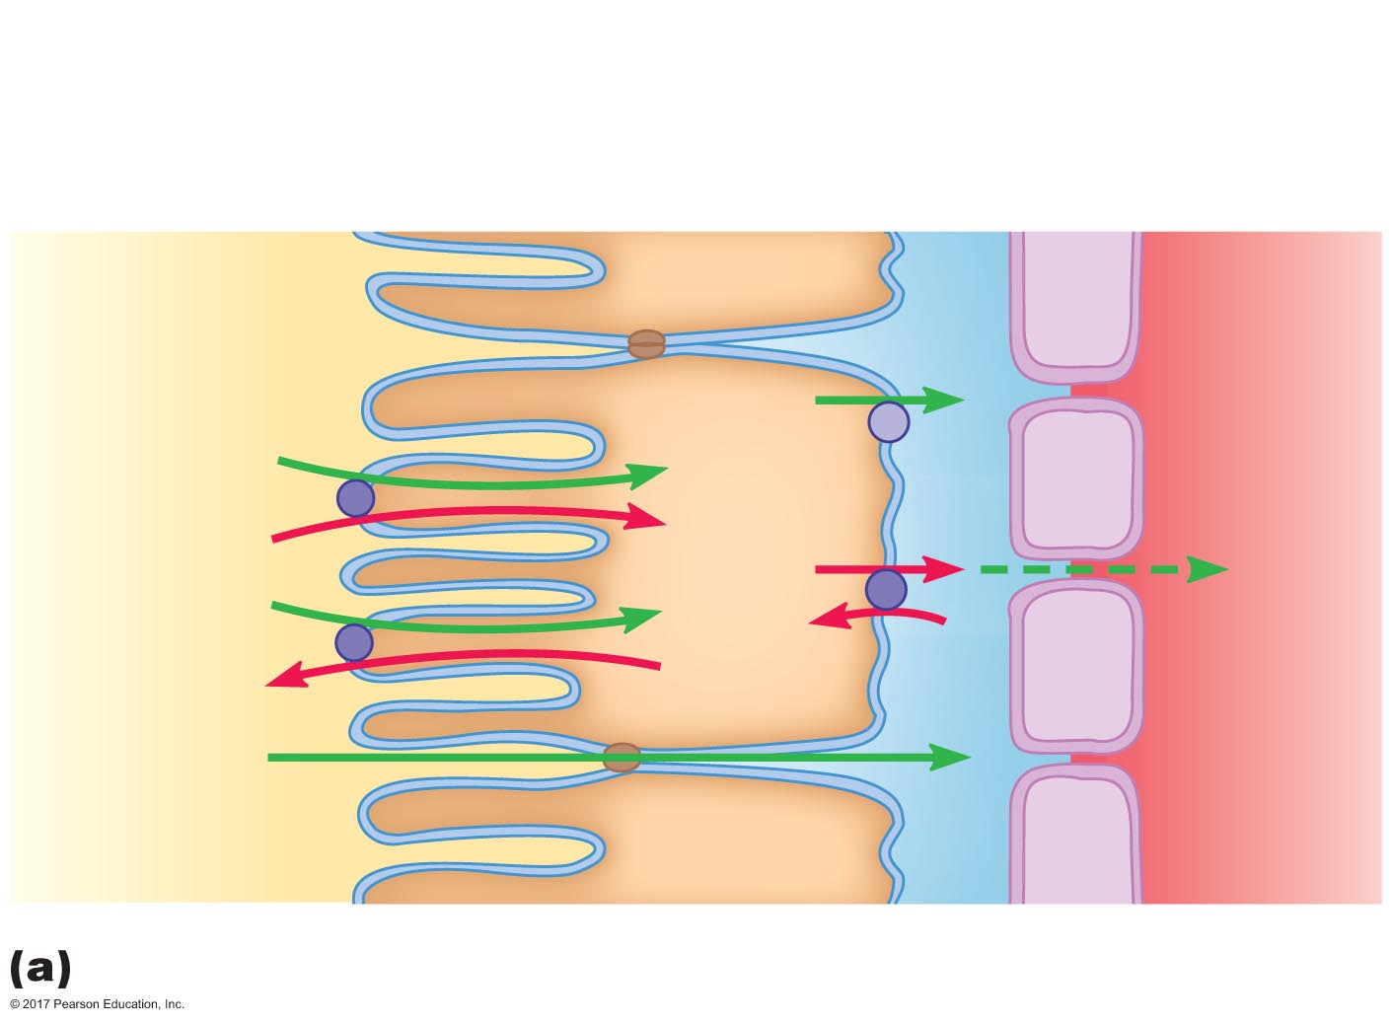
Figure 19.14a Mechanisms of sodium reabsorption in the proximal and distal tubules.
Peritubular ﬂuid
Apical
membrane
Proximal tubule
epithelial cell
Basolateral
membrane
Capillary
endothelial cell
Tubular
ﬂuid
Plasma
X
Na⁺
X
Na⁺
Na⁺
Na⁺
K⁺
H⁺
Cl–
Sodium reabsorption in the proximal tubule

Slide 6
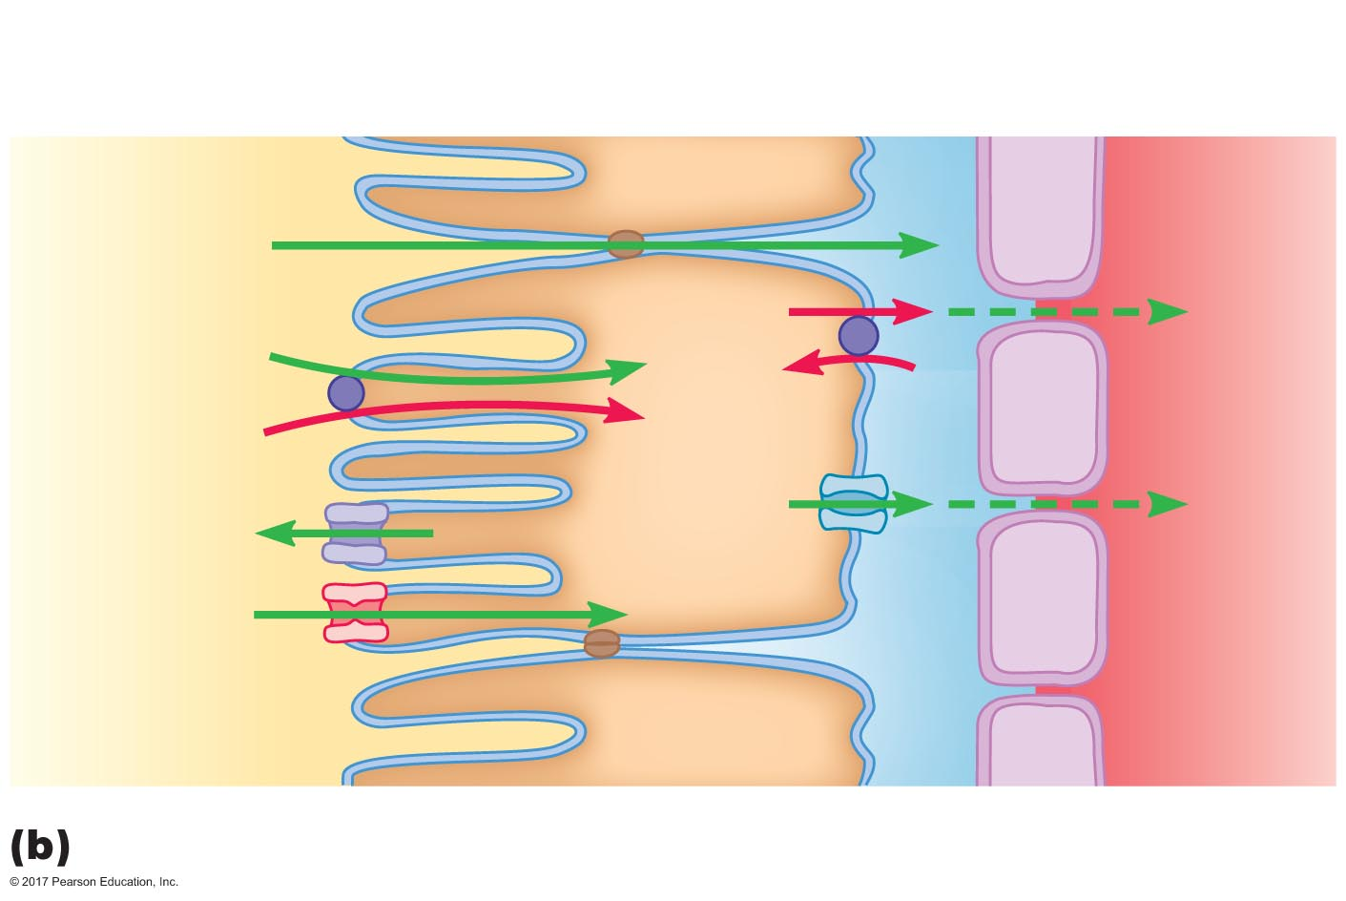
Figure 19.14b Mechanisms of sodium reabsorption in the proximal and distal tubules.
Distal tubule
epithelial cell
Cl–
Na⁺
Na⁺
Na⁺
K⁺
Cl–
Cl–
Cl–
K⁺
Na⁺
Sodium reabsorption in the distal tubule

Slide 7
The Effects of Aldosterone
Increases sodium reabsorption
Steroid hormone secreted from adrenal cortex
Acts on principal cells of distal tubules and collecting ducts
Increases number of Na⁺/K⁺ pumps on basolateral membrane
Increases number of open Na⁺ and K⁺ channels on apical membrane

Slide 8
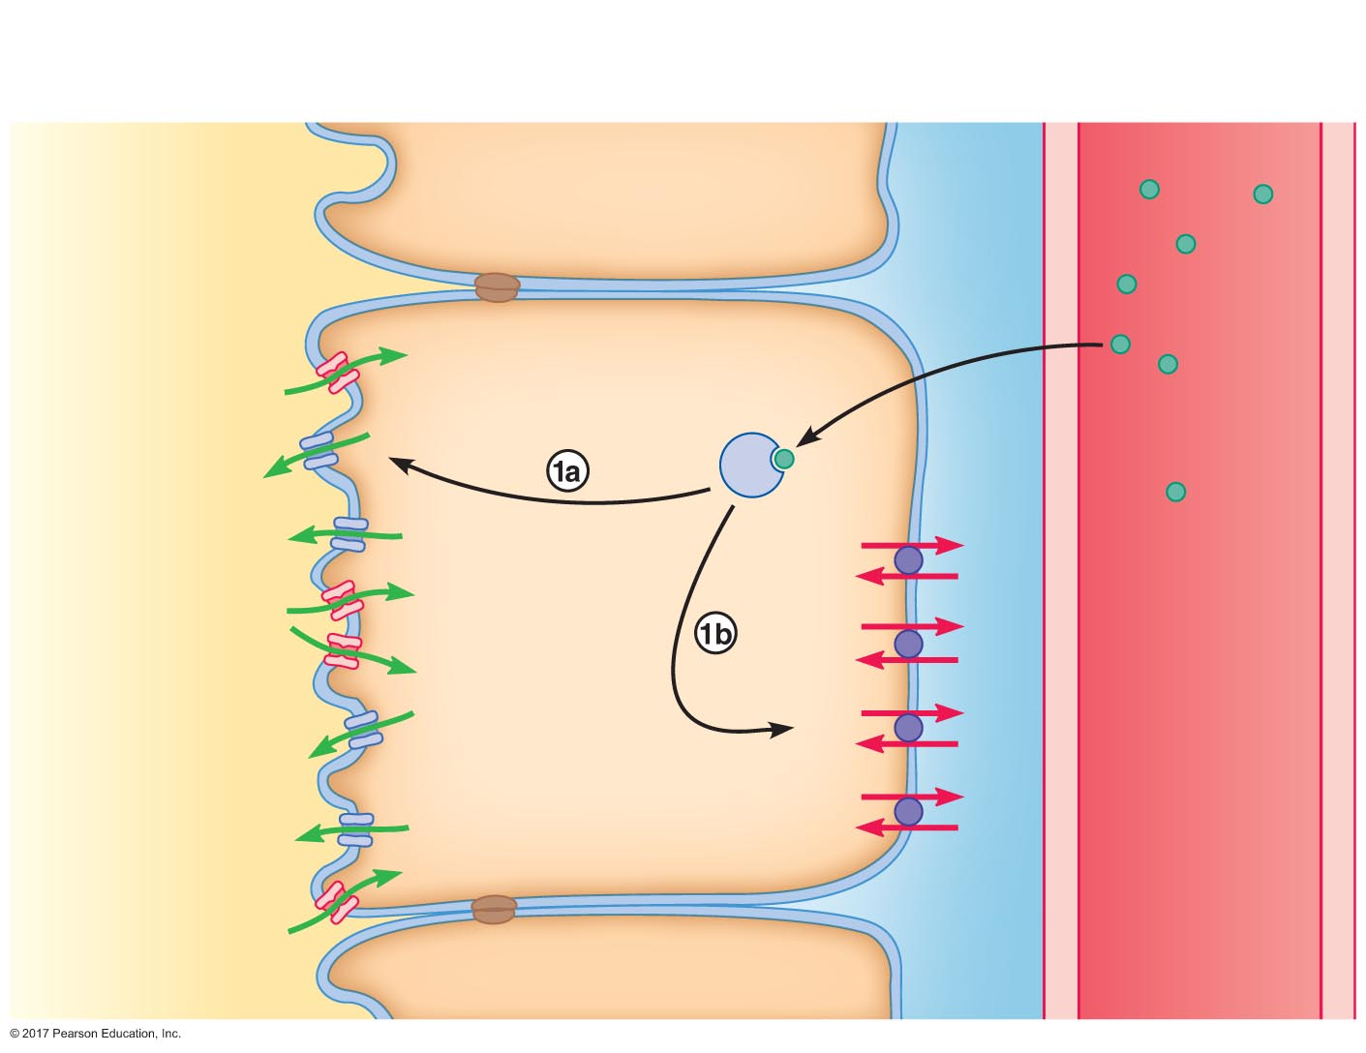
Figure 19.15 Effects of aldosterone on principal cells of the distal tubules and collecting ducts.
Lumen of late distal
tubule or collecting duct
Basolateral
membrane
Peritubular
ﬂuid
Peritubular
capillary
Principal cell
Apical
membrane
Na⁺
Cytosolic
receptor
Aldosterone
K⁺
K⁺
Na⁺
K⁺
Na⁺
Na⁺
Na⁺
K⁺
Na⁺
K⁺
K⁺
Na⁺
K⁺
K⁺
Na⁺
Tubular ﬂuid
Plasma

Slide 9
The Effects of Aldosterone
Renin-angiotensin-aldosterone system (RAAS)
Granular cells of juxtaglomerular apparatus secrete renin
Capillary walls contain angiotensin-converting enzyme (ACE), especially in lungs
Liver secretes angiotensinogen
Angiotensinogen is converted by renin into angiotensin I
Angiotensin I is converted by ACE into angiotensin II
Angiotensin II stimulates aldosterone production

Slide 10
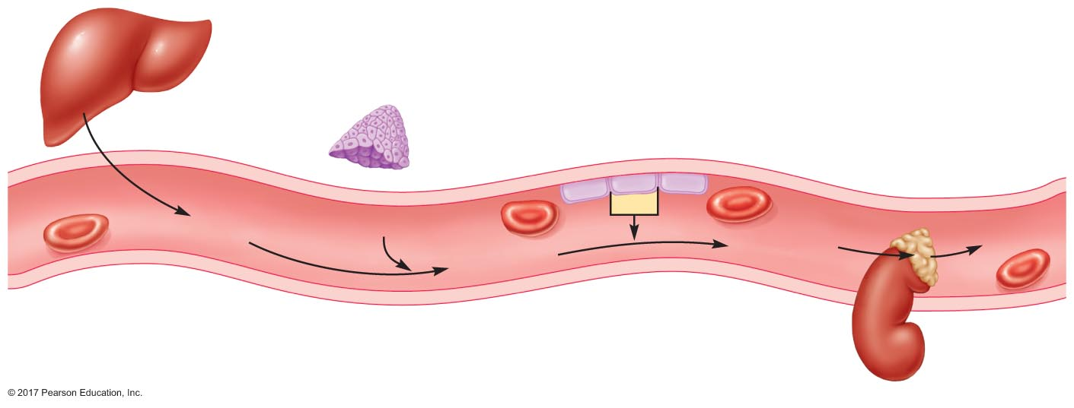
Figure 19.16 The renin-angiotensin-aldosterone system.
Slide 1
Liver
Juxtaglomerular
cells in kidney
Capillary endothelial cell
Adrenal
cortex
Blood
ACE
Angiotensinogen
Renin
Aldosterone
Angiotensin I
Angiotensin II

Slide 11
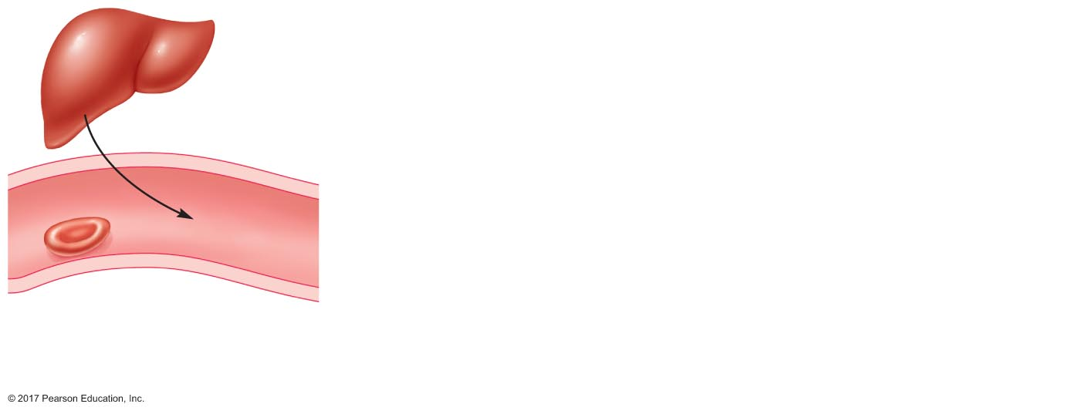
Figure 19.16 The renin-angiotensin-aldosterone system.
Slide 2
Liver
Blood
Angiotensinogen

Slide 12
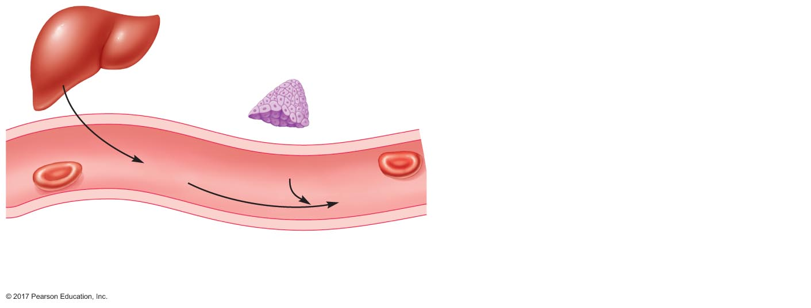
Figure 19.16 The renin-angiotensin-aldosterone system.
Slide 3
Liver
Juxtaglomerular
cells in kidney
Blood
Angiotensinogen
Renin
Angiotensin I

Slide 13
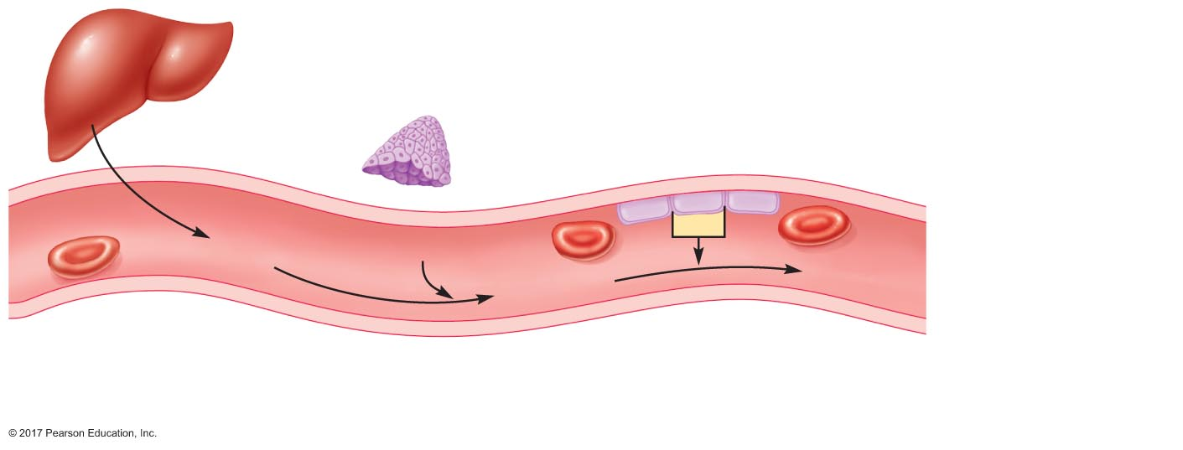
Figure 19.16 The renin-angiotensin-aldosterone system.
Slide 4
Liver
Juxtaglomerular
cells in kidney
Capillary endothelial cell
Blood
ACE
Angiotensinogen
Renin
Angiotensin I
Angiotensin II

Slide 14
Figure 19.16 The renin-angiotensin-aldosterone system.
Slide 5
Liver
Juxtaglomerular
cells in kidney
Capillary endothelial cell
Adrenal
cortex
Blood
ACE
Angiotensinogen
Renin
Aldosterone
Angiotensin I
Angiotensin II

Slide 15
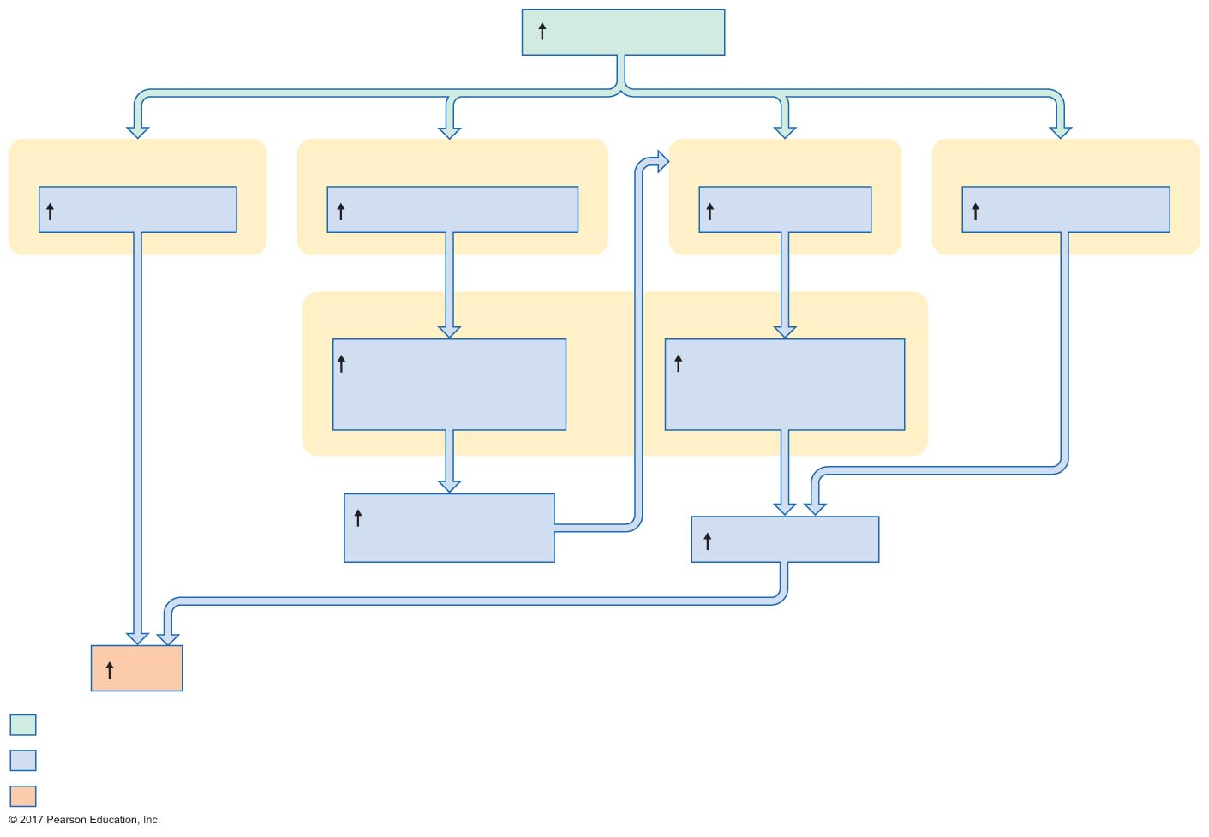
Figure 19.17 Mechanisms by which angiotensin II increases mean arterial pressure.
Slide 1
Angiotensin II
Systemic arterioles
Adrenal cortex
Posterior pituitary
Hypothalamic neurons
Vasoconstriction
Aldosterone secretion
ADH secretion
Thirst stimulation
Kidneys
Sodium reabsorption
in late distal tubules
and collecting ducts
Water reabsorption
in late distal tubules
and collecting ducts
Extracellular ﬂuid
osmolarity
Plasma volume
MAP
Initial stimulus
Physiological response
Result

Slide 16
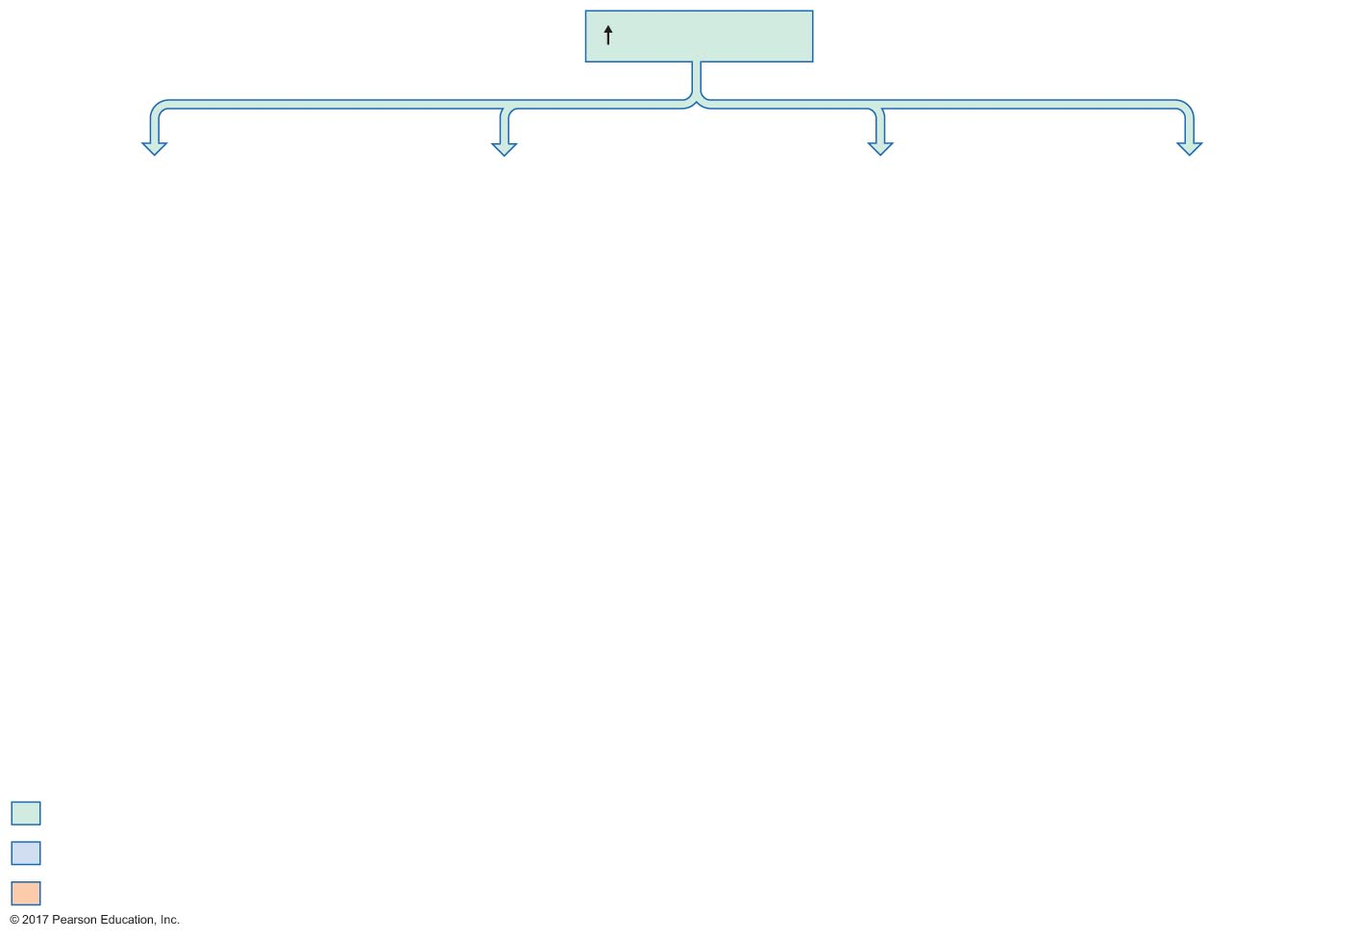
Figure 19.17 Mechanisms by which angiotensin II increases mean arterial pressure.
Slide 2
Angiotensin II
Initial stimulus
Physiological response
Result

Slide 17
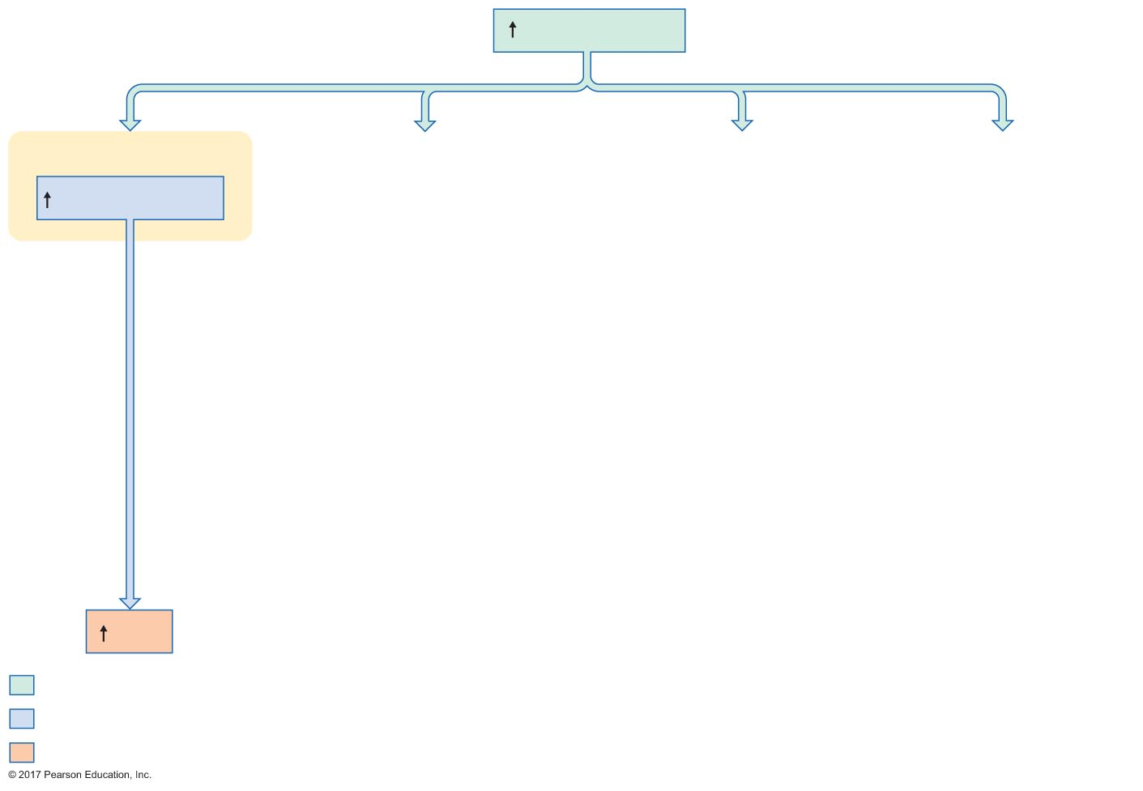
Figure 19.17 Mechanisms by which angiotensin II increases mean arterial pressure.
Slide 3
Angiotensin II
Systemic arterioles
Vasoconstriction
MAP
Initial stimulus
Physiological response
Result

Slide 18
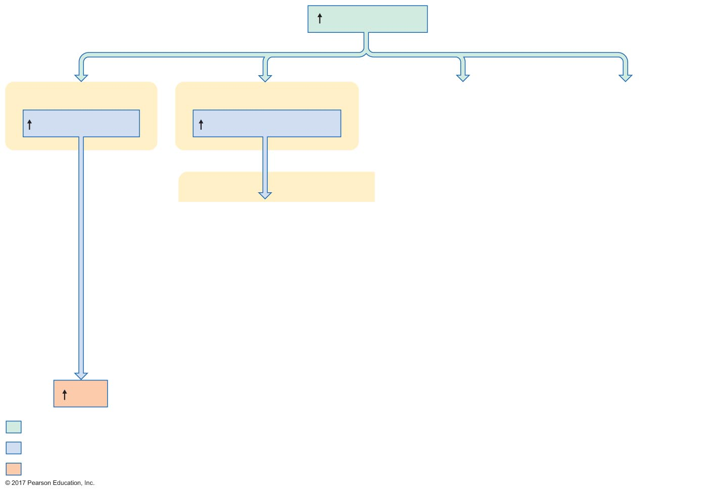
Figure 19.17 Mechanisms by which angiotensin II increases mean arterial pressure.
Slide 4
Angiotensin II
Systemic arterioles
Adrenal cortex
Vasoconstriction
Aldosterone secretion
Kidneys
MAP
Initial stimulus
Physiological response
Result

Slide 19
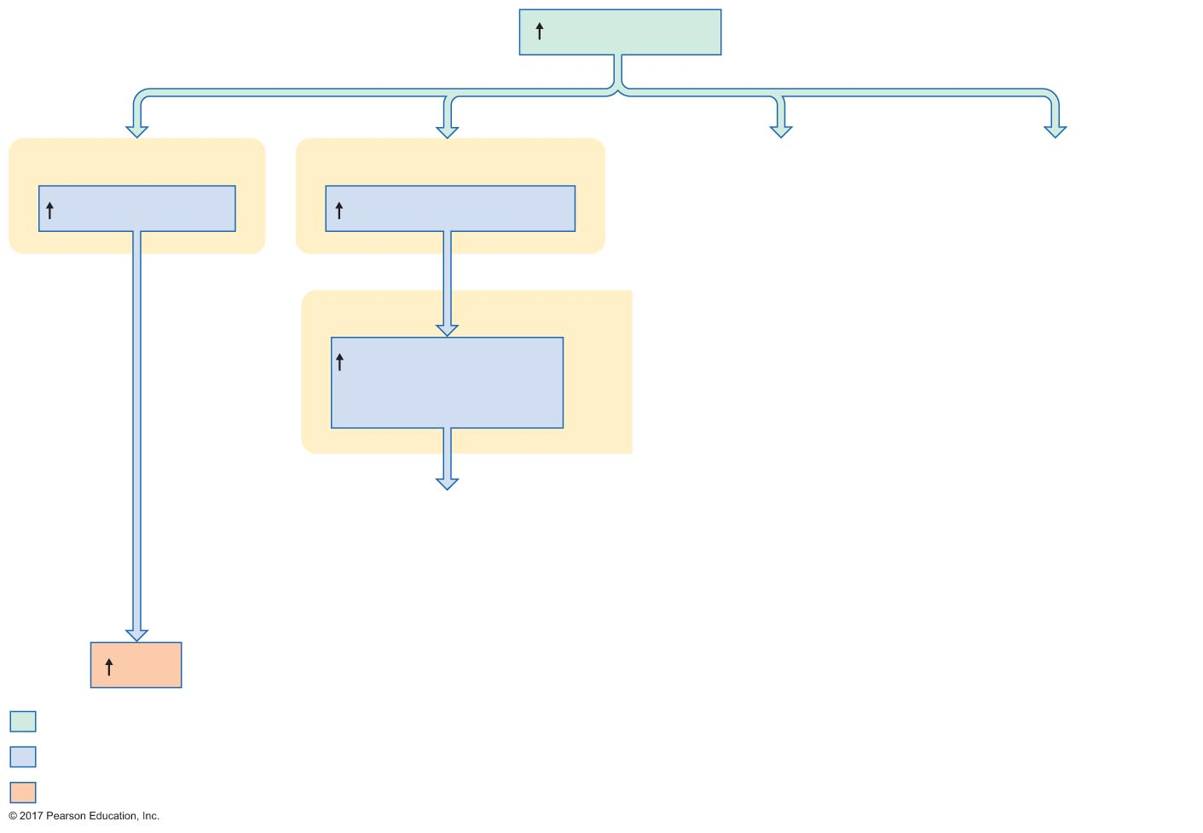
Figure 19.17 Mechanisms by which angiotensin II increases mean arterial pressure.
Slide 5
Angiotensin II
Systemic arterioles
Adrenal cortex
Vasoconstriction
Aldosterone secretion
Kidneys
Sodium reabsorption
in late distal tubules
and collecting ducts
MAP
Initial stimulus
Physiological response
Result

Slide 20
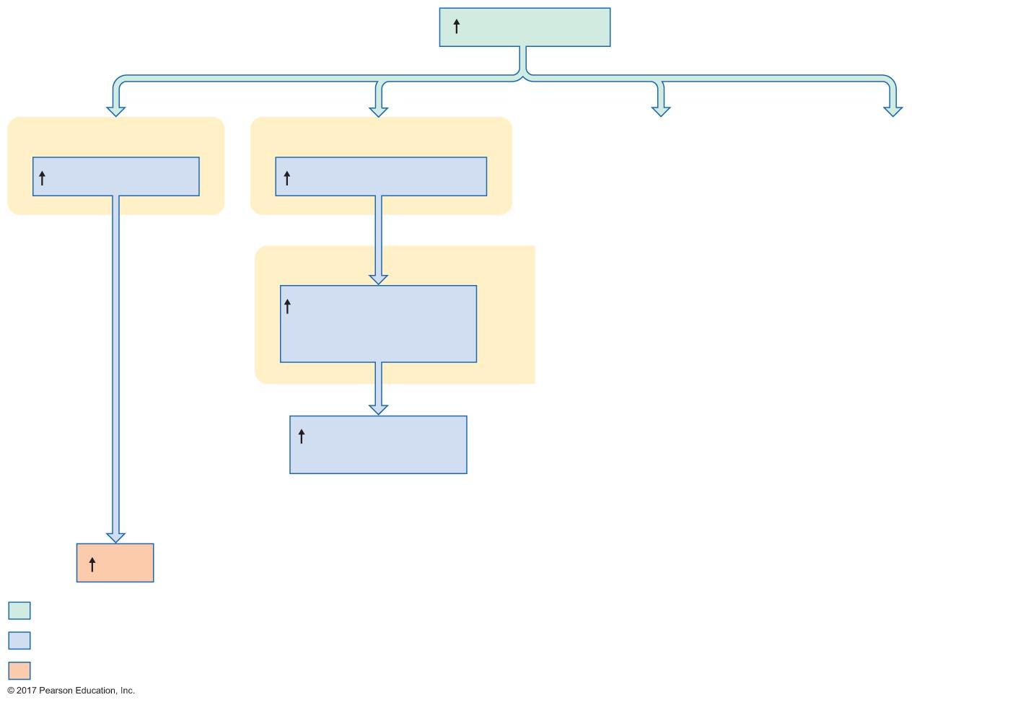
Figure 19.17 Mechanisms by which angiotensin II increases mean arterial pressure.
Slide 6
Angiotensin II
Systemic arterioles
Adrenal cortex
Vasoconstriction
Aldosterone secretion
Kidneys
Sodium reabsorption
in late distal tubules
and collecting ducts
Extracellular ﬂuid
osmolarity
MAP
Initial stimulus
Physiological response
Result

Slide 21
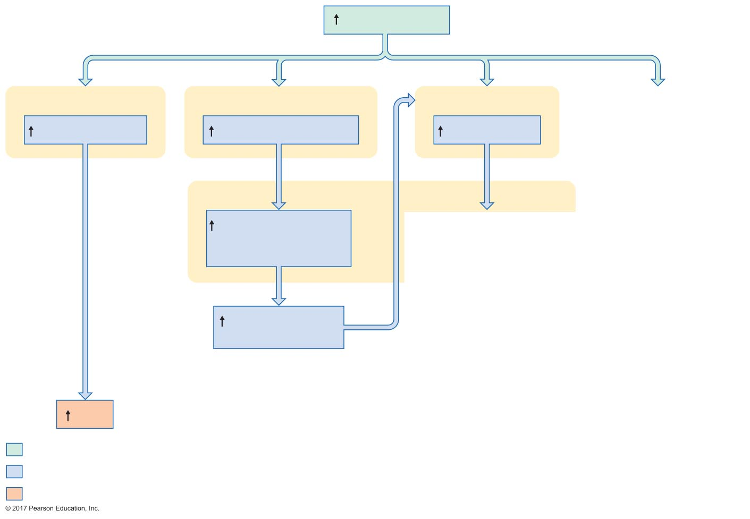
Figure 19.17 Mechanisms by which angiotensin II increases mean arterial pressure.
Slide 7
Angiotensin II
Systemic arterioles
Adrenal cortex
Posterior pituitary
Vasoconstriction
Aldosterone secretion
ADH secretion
Kidneys
Sodium reabsorption
in late distal tubules
and collecting ducts
Extracellular ﬂuid
osmolarity
MAP
Initial stimulus
Physiological response
Result

Slide 22
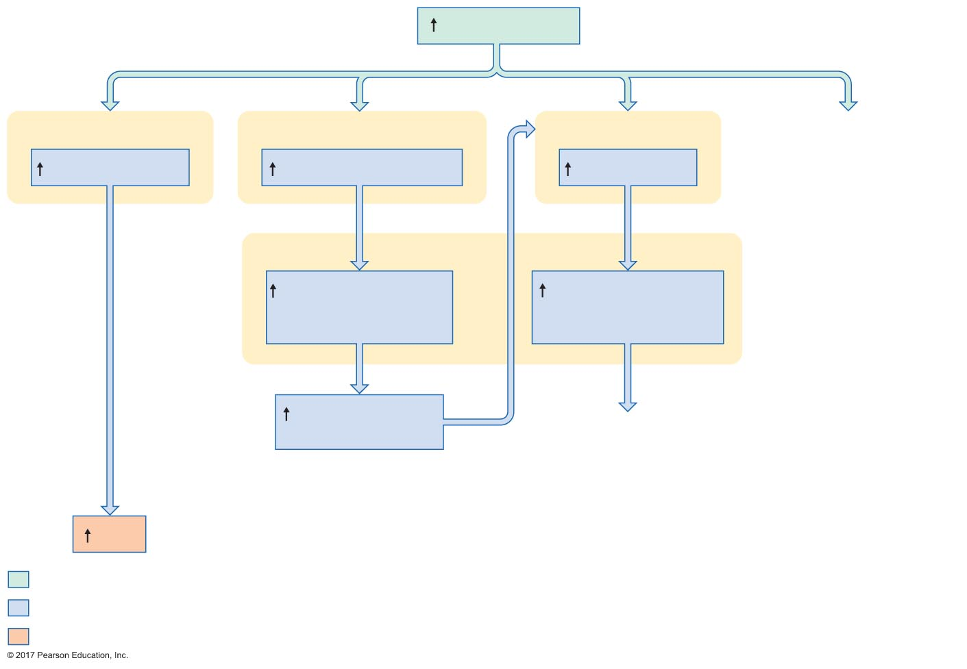
Figure 19.17 Mechanisms by which angiotensin II increases mean arterial pressure.
Slide 8
Angiotensin II
Systemic arterioles
Adrenal cortex
Posterior pituitary
Vasoconstriction
Aldosterone secretion
ADH secretion
Kidneys
Sodium reabsorption
in late distal tubules
and collecting ducts
Water reabsorption
in late distal tubules
and collecting ducts
Extracellular ﬂuid
osmolarity
MAP
Initial stimulus
Physiological response
Result

Slide 23
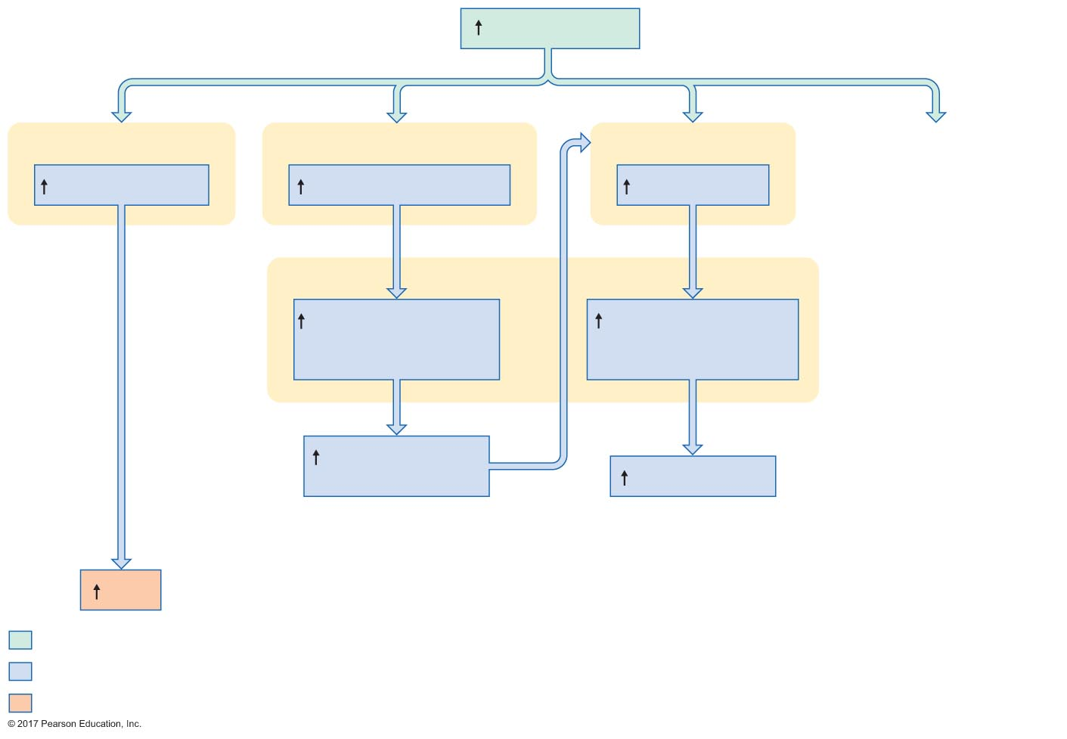
Figure 19.17 Mechanisms by which angiotensin II increases mean arterial pressure.
Slide 9
Angiotensin II
Systemic arterioles
Adrenal cortex
Posterior pituitary
Vasoconstriction
Aldosterone secretion
ADH secretion
Kidneys
Sodium reabsorption
in late distal tubules
and collecting ducts
Water reabsorption
in late distal tubules
and collecting ducts
Extracellular ﬂuid
osmolarity
Plasma volume
MAP
Initial stimulus
Physiological response
Result

Slide 24
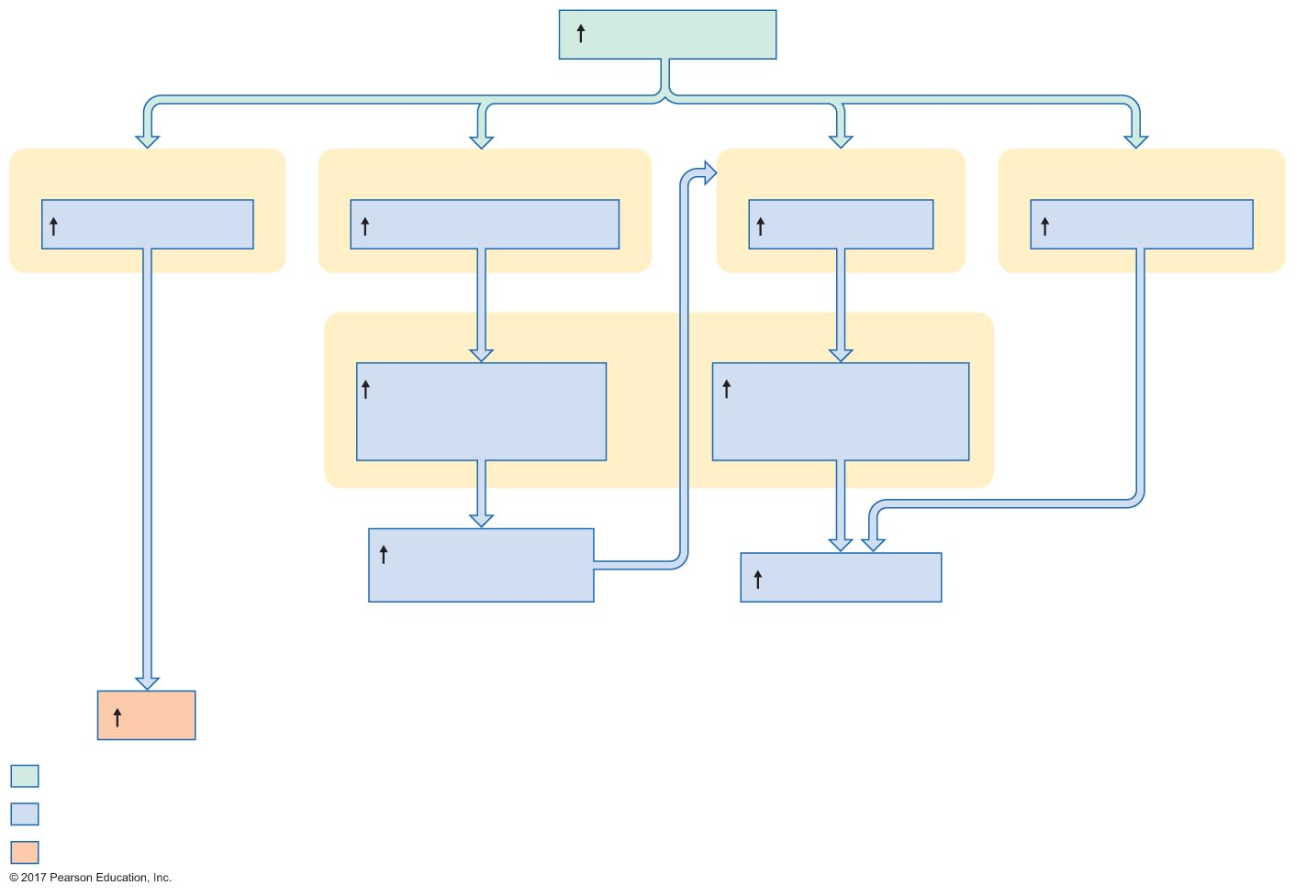
Figure 19.17 Mechanisms by which angiotensin II increases mean arterial pressure.
Slide 10
Angiotensin II
Systemic arterioles
Adrenal cortex
Posterior pituitary
Hypothalamic neurons
Vasoconstriction
Aldosterone secretion
ADH secretion
Thirst stimulation
Kidneys
Sodium reabsorption
in late distal tubules
and collecting ducts
Water reabsorption
in late distal tubules
and collecting ducts
Extracellular ﬂuid
osmolarity
Plasma volume
MAP
Initial stimulus
Physiological response
Result

Slide 25
Figure 19.17 Mechanisms by which angiotensin II increases mean arterial pressure.
Slide 11
Angiotensin II
Systemic arterioles
Adrenal cortex
Posterior pituitary
Hypothalamic neurons
Vasoconstriction
Aldosterone secretion
ADH secretion
Thirst stimulation
Kidneys
Sodium reabsorption
in late distal tubules
and collecting ducts
Water reabsorption
in late distal tubules
and collecting ducts
Extracellular ﬂuid
osmolarity
Plasma volume
MAP
Initial stimulus
Physiological response
Result

Slide 26
The Effects of Aldosterone
Stimuli for renin release
Decreased pressure in afferent arteriole
Renal sympathetic nerve activity
Decreases in Na⁺ and Cl– in distal tubule filtrate

Slide 27
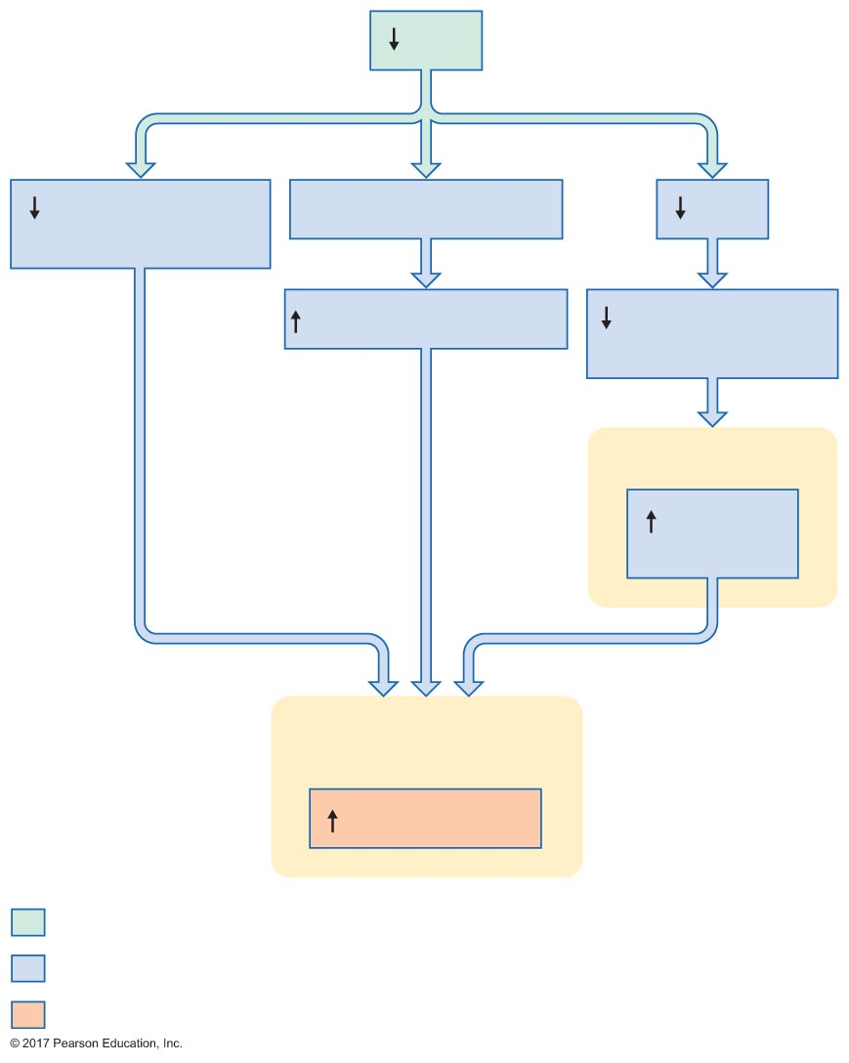
Figure 19.18 Mechanisms by which decreases in mean arterial pressure stimulate renin release.
Slide 1
MAP
Afferent arteriole
pressure
Baroreceptor reﬂex
GFR
Sympathetic activity
[Na⁺] and [Cl–]
in distal tubules
Macula densa
Paracrine
secretion
Juxtaglomerular cells
of afferent arteriole
Renin release
Initial stimulus
Physiological response
Result

Slide 28
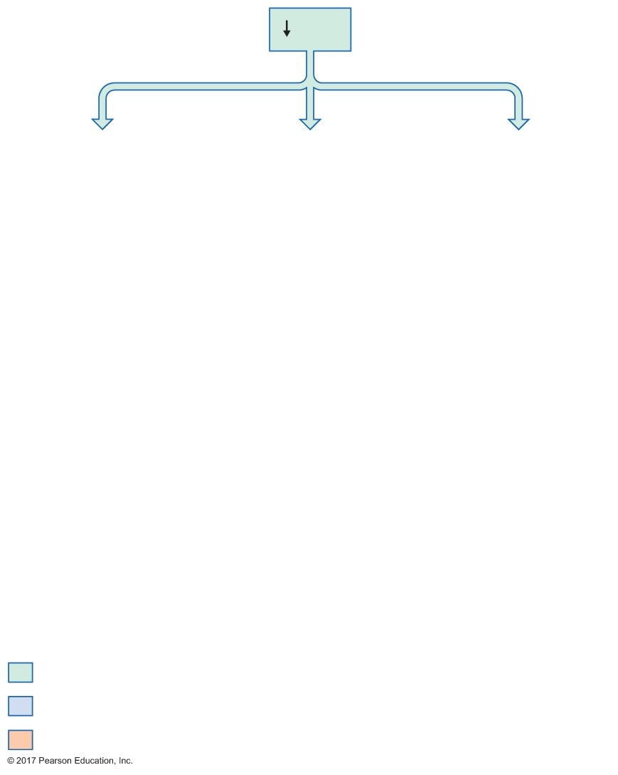
Figure 19.18 Mechanisms by which decreases in mean arterial pressure stimulate renin release.
Slide 2
MAP
Initial stimulus
Physiological response
Result

Slide 29
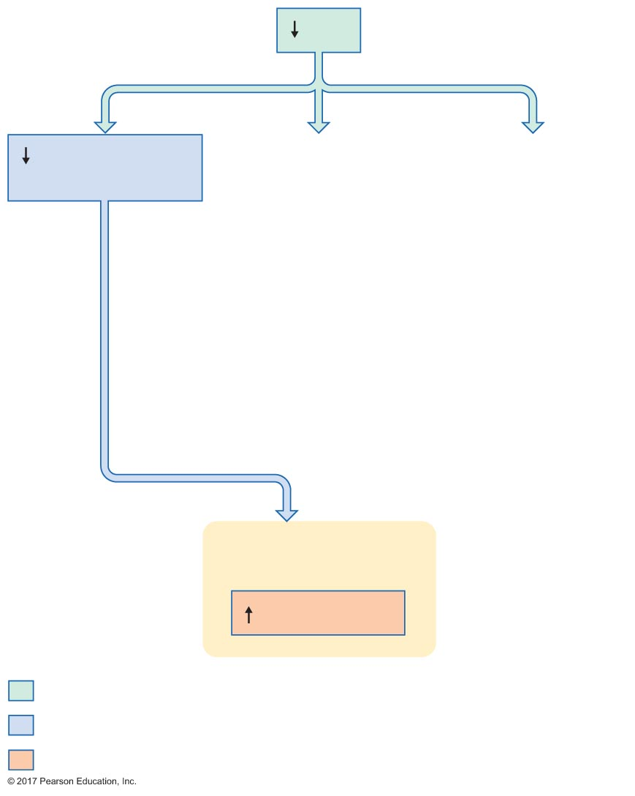
Figure 19.18 Mechanisms by which decreases in mean arterial pressure stimulate renin release.
Slide 3
MAP
Afferent arteriole
pressure
Juxtaglomerular cells
of afferent arteriole
Renin release
Initial stimulus
Physiological response
Result

Slide 30
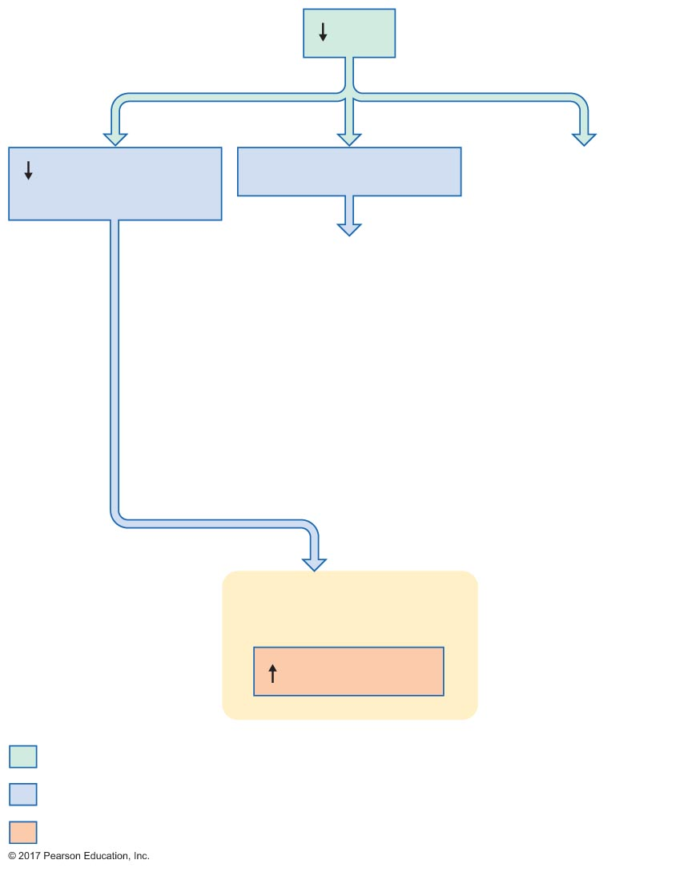
Figure 19.18 Mechanisms by which decreases in mean arterial pressure stimulate renin release.
Slide 4
MAP
Afferent arteriole
pressure
Baroreceptor reﬂex
Juxtaglomerular cells
of afferent arteriole
Renin release
Initial stimulus
Physiological response
Result

Slide 31
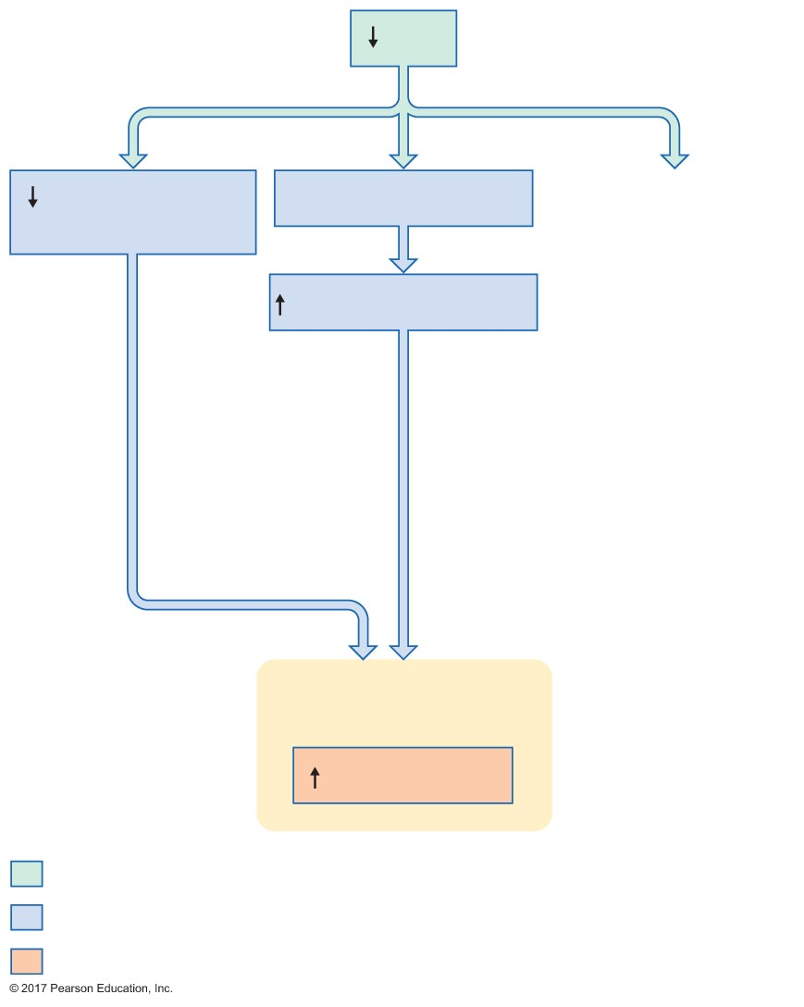
Figure 19.18 Mechanisms by which decreases in mean arterial pressure stimulate renin release.
Slide 5
MAP
Afferent arteriole
pressure
Baroreceptor reﬂex
Sympathetic activity
Juxtaglomerular cells
of afferent arteriole
Renin release
Initial stimulus
Physiological response
Result

Slide 32
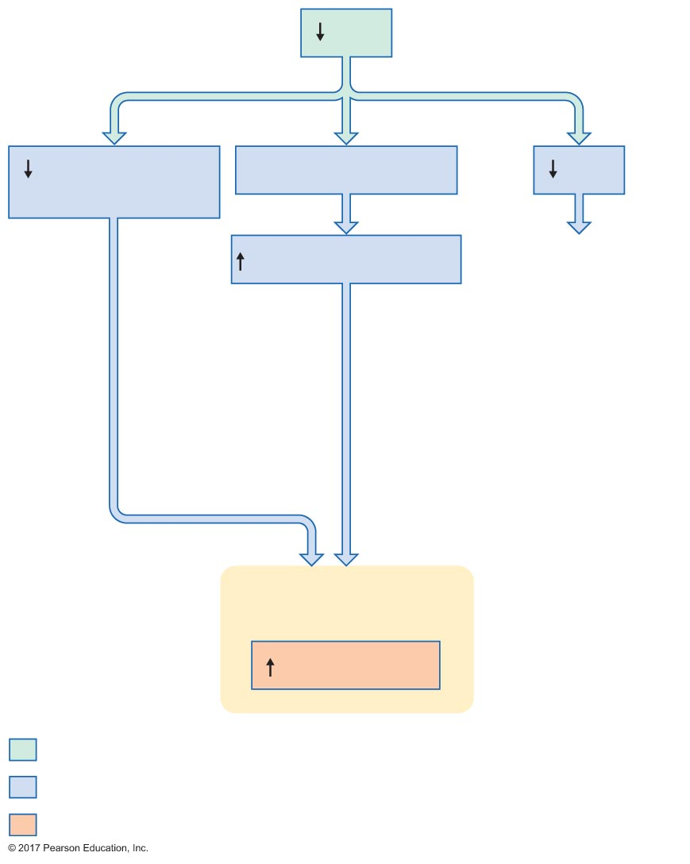
Figure 19.18 Mechanisms by which decreases in mean arterial pressure stimulate renin release.
Slide 6
MAP
Afferent arteriole
pressure
Baroreceptor reﬂex
GFR
Sympathetic activity
Juxtaglomerular cells
of afferent arteriole
Renin release
Initial stimulus
Physiological response
Result

Slide 33
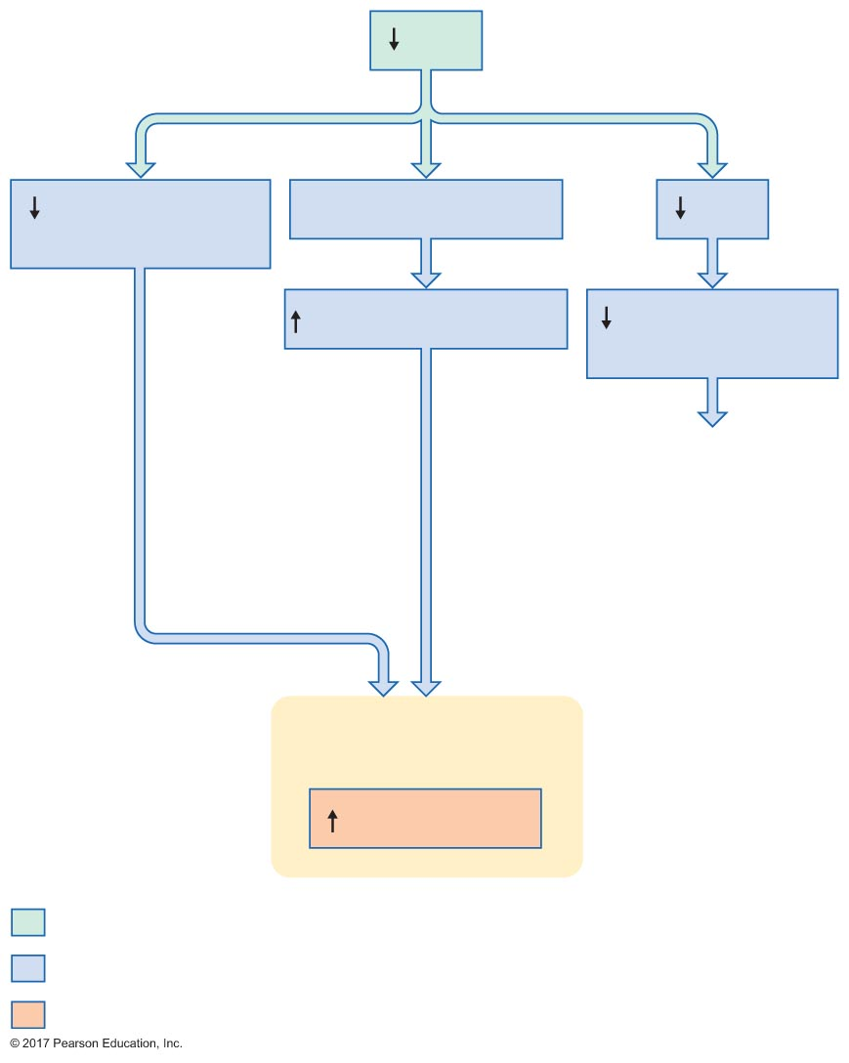
Figure 19.18 Mechanisms by which decreases in mean arterial pressure stimulate renin release.
Slide 7
MAP
Afferent arteriole
pressure
Baroreceptor reﬂex
GFR
Sympathetic activity
[Na⁺] and [Cl–]
in distal tubules
Juxtaglomerular cells
of afferent arteriole
Renin release
Initial stimulus
Physiological response
Result

Slide 34
Figure 19.18 Mechanisms by which decreases in mean arterial pressure stimulate renin release.
Slide 8
MAP
Afferent arteriole
pressure
Baroreceptor reﬂex
GFR
Sympathetic activity
[Na⁺] and [Cl–]
in distal tubules
Macula densa
Paracrine
secretion
Juxtaglomerular cells
of afferent arteriole
Renin release
Initial stimulus
Physiological response
Result

Slide 35
Atrial Natriuretic Peptide
Secreted by atrial cells in response to distension of atrial wall
Increases GFR
Dilation of afferent arteriole
Constriction of efferent arteriole
Decreases Na⁺ reabsorption by closing Na⁺ channels in apical membrane
Overall effect: increased Na⁺ excretion

Slide 36
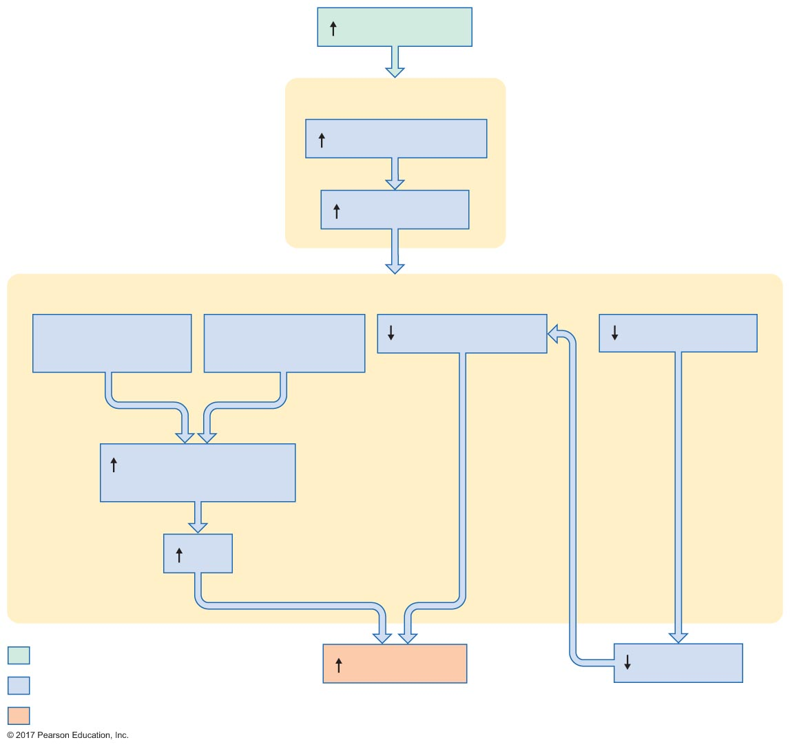
Figure 19.19 Mechanisms by which secretion of atrial natriuretic peptide increases sodium excretion in response to increased plasma volume.
Slide 1
Plasma volume
Atria
Atrial wall stretch
ANP secretion
Kidneys
Afferent arteriole
dilation
Efferent arteriole
constriction
Na⁺ reabsorption
Renin secretion
Glomerular capillary
pressure
GFR
Initial stimulus
Na⁺ excretion
Aldosterone
Physiological response
Result

Slide 37
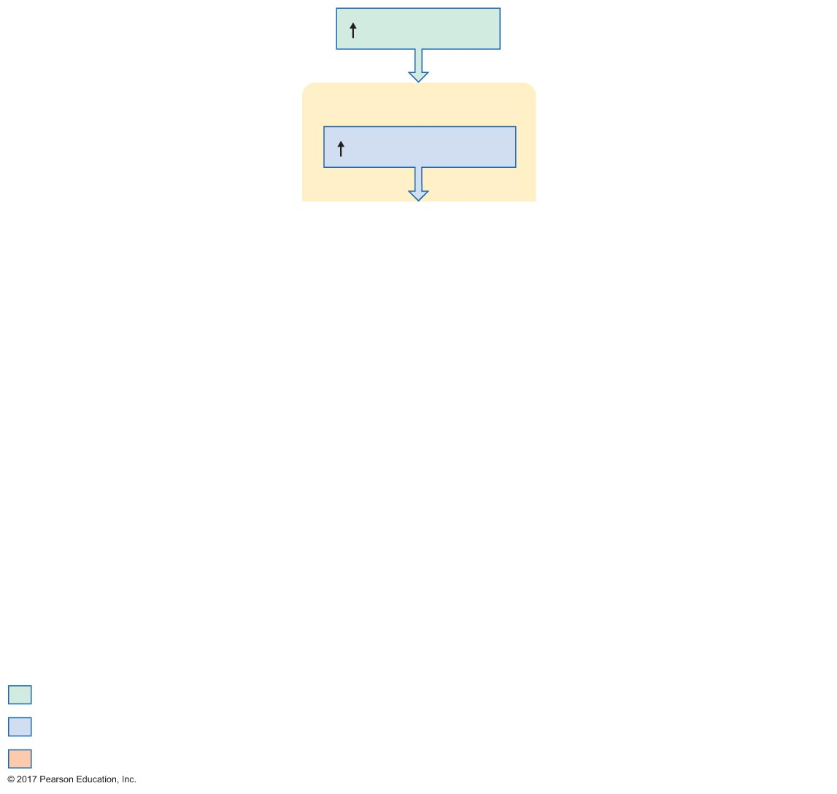
Figure 19.19 Mechanisms by which secretion of atrial natriuretic peptide increases sodium excretion in response to increased plasma volume.
Slide 2
Plasma volume
Atria
Atrial wall stretch
Initial stimulus
Physiological response
Result

Slide 38
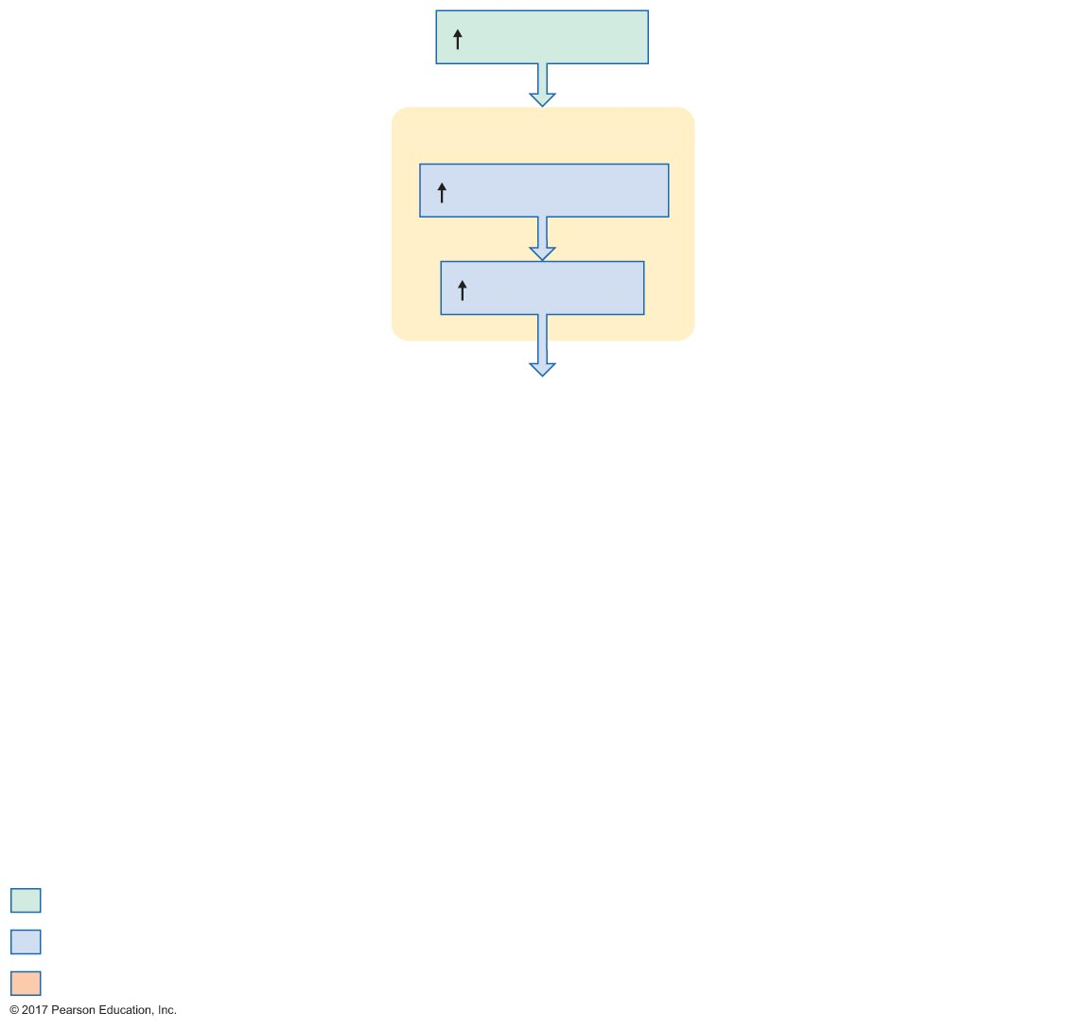
Figure 19.19 Mechanisms by which secretion of atrial natriuretic peptide increases sodium excretion in response to increased plasma volume.
Slide 3
Plasma volume
Atria
Atrial wall stretch
ANP secretion
Initial stimulus
Physiological response
Result

Slide 39
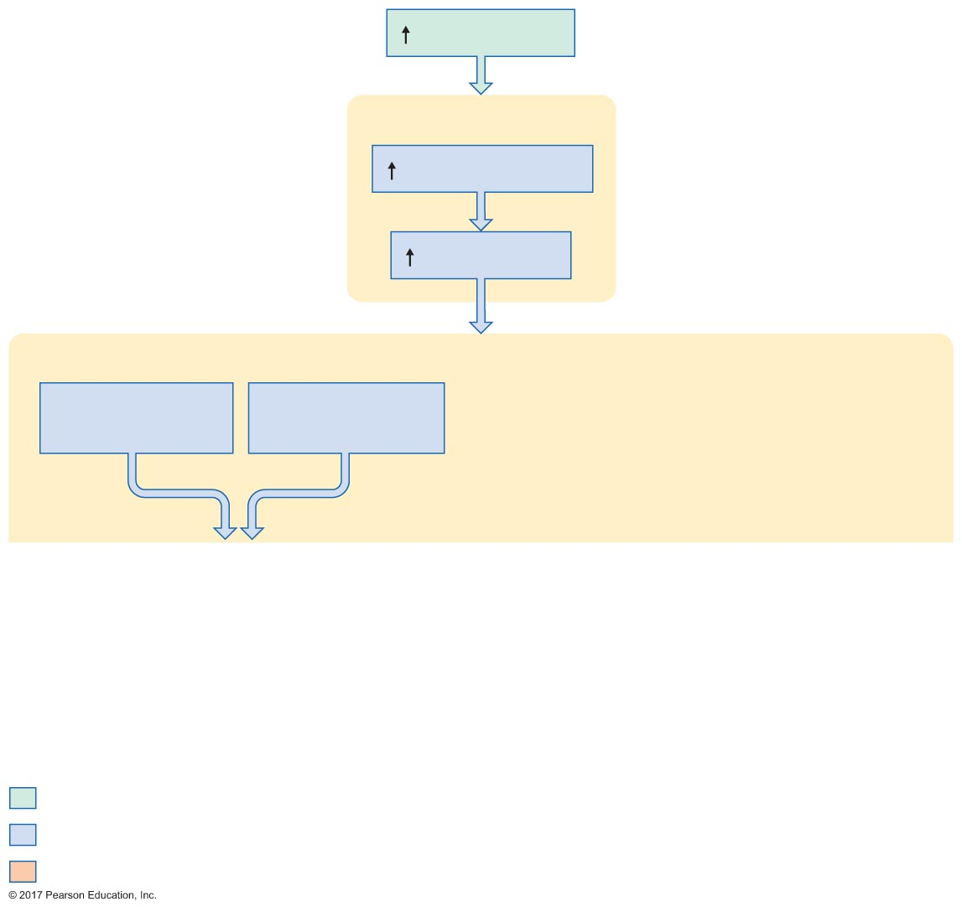
Figure 19.19 Mechanisms by which secretion of atrial natriuretic peptide increases sodium excretion in response to increased plasma volume.
Slide 4
Plasma volume
Atria
Atrial wall stretch
ANP secretion
Kidneys
Afferent arteriole
dilation
Efferent arteriole
constriction
Initial stimulus
Physiological response
Result

Slide 40
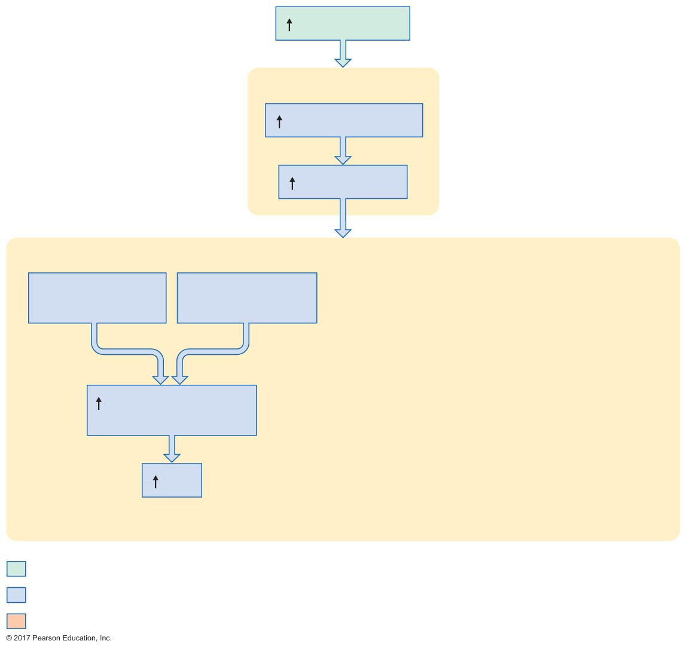
Figure 19.19 Mechanisms by which secretion of atrial natriuretic peptide increases sodium excretion in response to increased plasma volume.
Slide 5
Plasma volume
Atria
Atrial wall stretch
ANP secretion
Kidneys
Afferent arteriole
dilation
Efferent arteriole
constriction
Glomerular capillary
pressure
GFR
Initial stimulus
Physiological response
Result

Slide 41
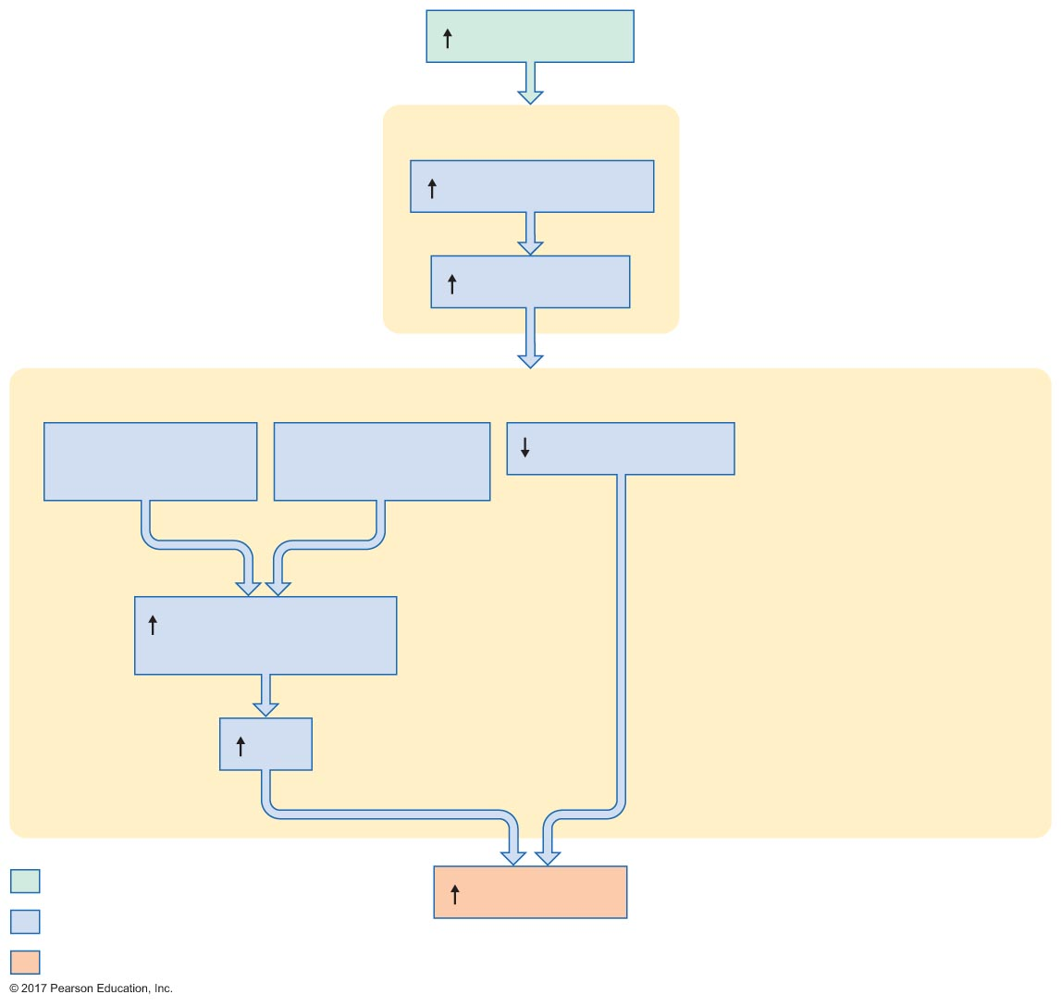
Figure 19.19 Mechanisms by which secretion of atrial natriuretic peptide increases sodium excretion in response to increased plasma volume.
Slide 6
Plasma volume
Atria
Atrial wall stretch
ANP secretion
Kidneys
Afferent arteriole
dilation
Efferent arteriole
constriction
Na⁺ reabsorption
Glomerular capillary
pressure
GFR
Initial stimulus
Na⁺ excretion
Physiological response
Result

Slide 42
Figure 19.19 Mechanisms by which secretion of atrial natriuretic peptide increases sodium excretion in response to increased plasma volume.
Slide 7
Plasma volume
Atria
Atrial wall stretch
ANP secretion
Kidneys
Afferent arteriole
dilation
Efferent arteriole
constriction
Na⁺ reabsorption
Renin secretion
Glomerular capillary
pressure
GFR
Initial stimulus
Na⁺ excretion
Aldosterone
Physiological response
Result

Slide 43
19.4 Potassium Balance
Hyperkalemia: high plasma potassium
Hypokalemia: low plasma potassium
Potassium is crucial to function of excitable cells

Slide 44
Renal Handling of Potassium Ions
Glomerulus: freely filtered
Proximal tubules: reabsorbed
Distal tubules and collecting ducts: reabsorbed and secreted
K⁺ secretion in distal tubules and collecting ducts is regulated
Aldosterone regulates principal cells
K⁺ in plasma directly stimulates aldosterone release
As K⁺ increases, more aldosterone is released

Slide 45
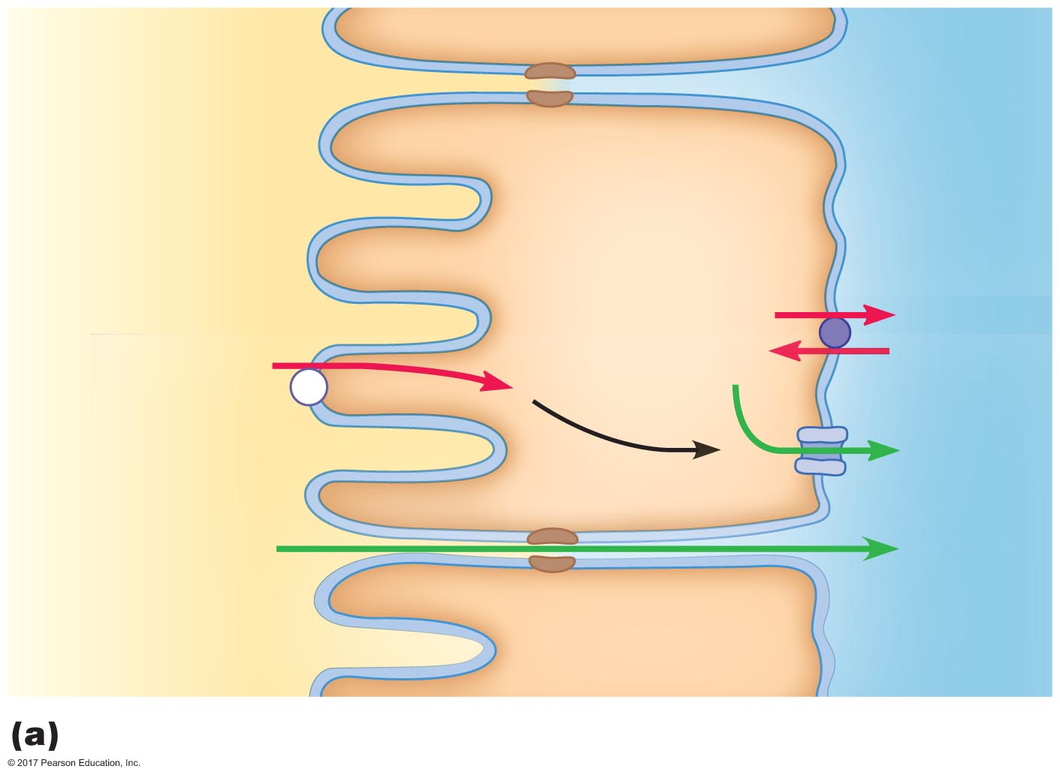
Figure 19.20a Potassium transport in renal tubules.
Apical
membrane
Basolateral
membrane
Proximal
tubule
epithelial cell
Lumen of
proximal
tubule
Na⁺
K⁺
K⁺
?
Unknown
mechanism
K⁺
K⁺
K⁺
Peritubular
ﬂuid
Tubular ﬂuid
Potassium reabsorption in the proximal tubule

Slide 46
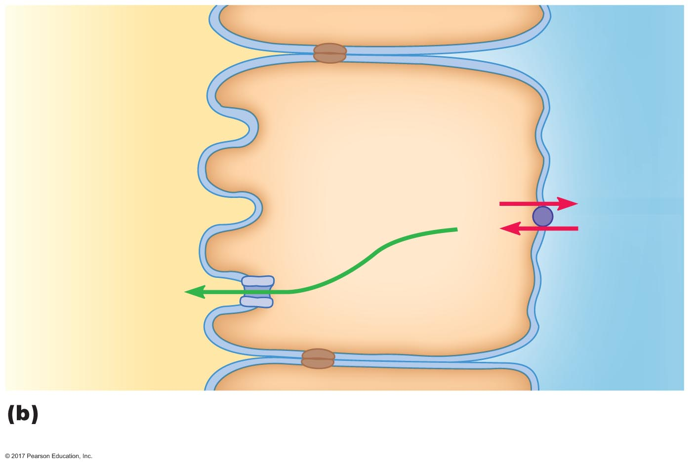
Figure 19.20b Potassium transport in renal tubules.
Apical
membrane
Basolateral
membrane
Principal cell
Lumen of late
distal tubule or
collecting duct
Na⁺
K⁺
K⁺
Peritubular
ﬂuid
Tubular ﬂuid
Potassium secretion in the principal cells of the late distal tubule
and collecting duct

Slide 47
19.5 Calcium Balance
Hypercalcemia: high plasma calcium
Hypocalcemia: low plasma calcium
Calcium balance is critical
Triggers exocytosis
Triggers secretion
Triggers muscle contraction
Increases contractility of cardiac and smooth muscle

Slide 48
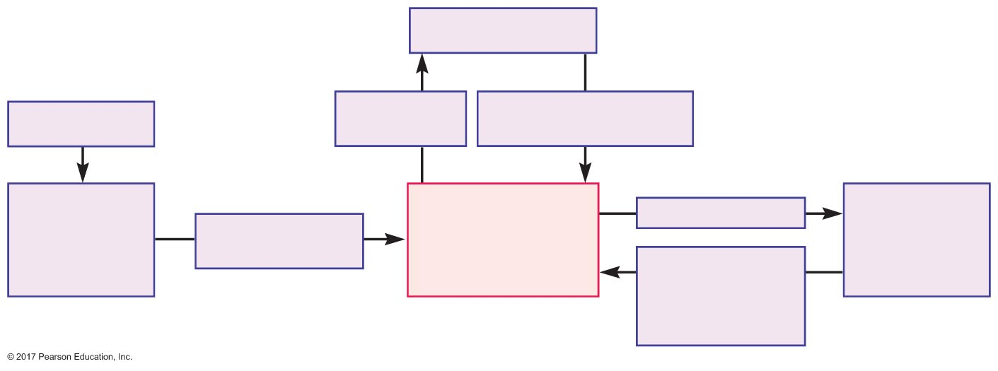
Figure 19.21 Routes of calcium exchange.
Bone
Calciﬁcation
(calcitonin)
Resorption
(PTH, 1,25-(OH₂)D₃)
Ingestion
Digestive
tract
Absorption
(1,25-(OH₂)D₃)
Plasma
[Ca²⁺]
Filtration
Kidneys
Reabsorption
(PTH stimulates,
calcitonin
inhibits)

Slide 49
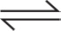
Renal Handling of Calcium
Blood calcium
Bound to carrier proteins
Free in plasma
Ca²⁺ + protein Ca-protein
Free calcium: freely filtered at glomerulus

Slide 50
Renal Handling of Calcium
99% of filtered calcium is reabsorbed
70% is reabsorbed in proximal tubules
19–20% is reabsorbed in thick ascending limbs of the loops of Henle
9–10% is reabsorbed in distal tubules
Reabsorption in loops of Henle and distal tubules is regulated

Slide 51
Hormonal Control of Plasma Calcium Concentrations
Parathyroid hormone (PTH): released from parathyroid glands
Stimulus: decreased Ca²⁺ in plasma
Actions
Increases Ca²⁺ reabsorption by kidneys
Stimulates activation of 1,25-dihydroxycholecalciferol in kidneys
Stimulates resorption of bone
Stimulates small increase in calcium absorption
Overall effect: increased blood calcium

Slide 52
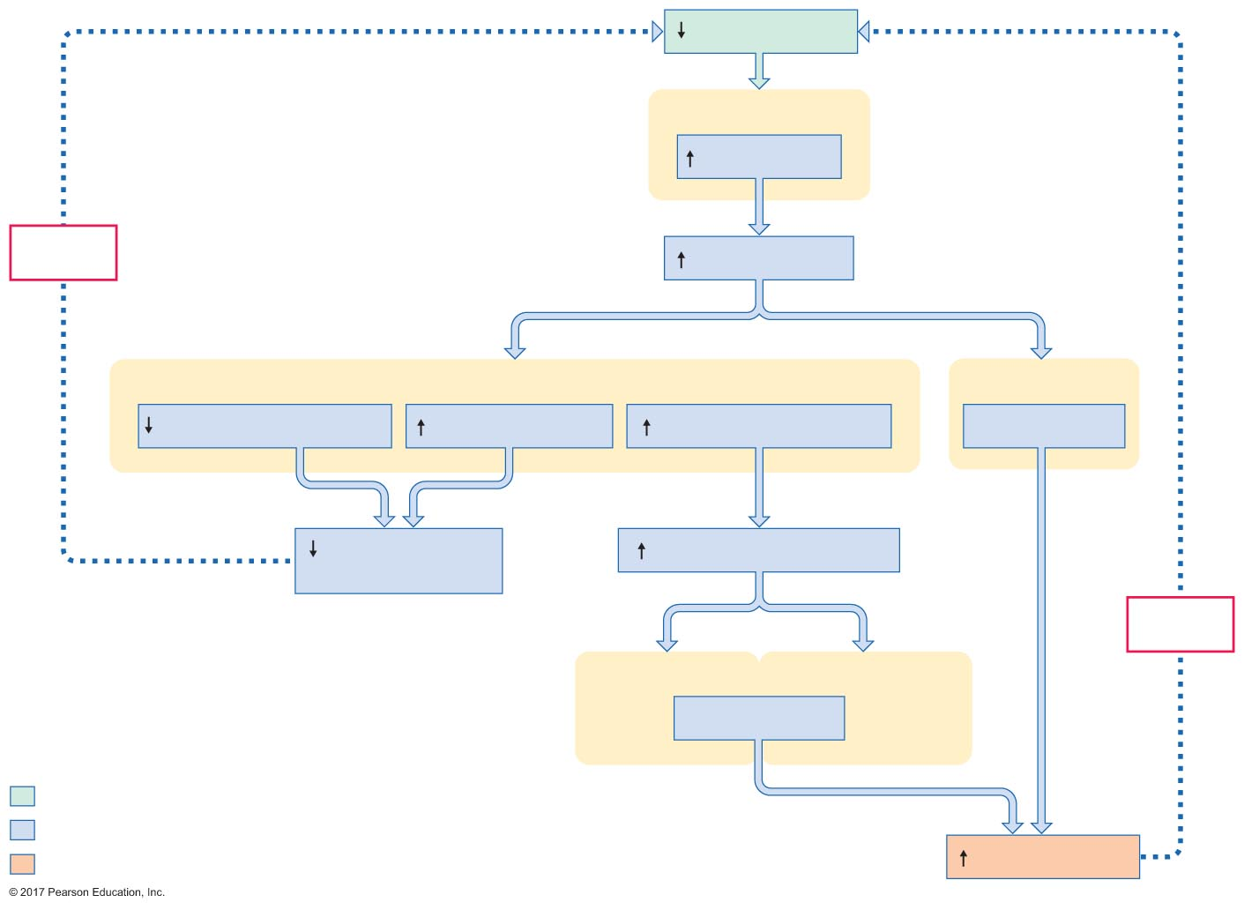
Figure 19.22 Role of parathyroid hormone in calcium balance.
Slide 1
[Ca²⁺] in plasma
Parathyroid glands
PTH secretion
Negative
feedback
[PTH] in plasma
Kidneys
Bone
Phosphate reabsorption
Ca²⁺ reabsorption
1,25-(OH₂)D₃ activation
Ca²⁺ resorption
Calcium excretion
in urine
[1,25-(OH₂)D₃] in plasma
Negative
feedback
Kidneys
Gastrointestinal tract
Ca²⁺ absorption
Initial stimulus
Physiological response
Result
[Ca²⁺] in plasma

Slide 53
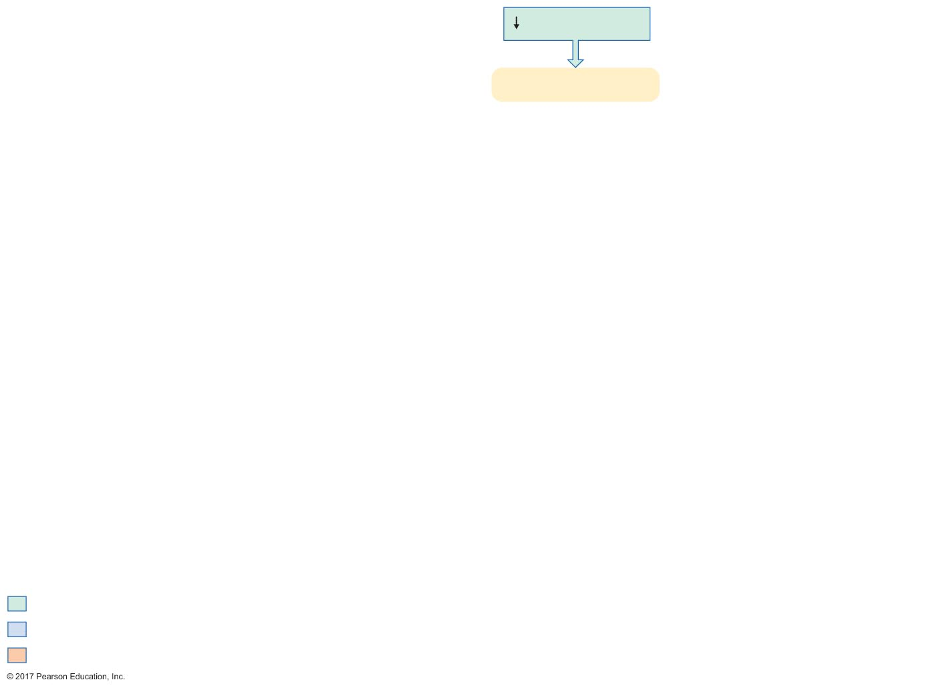
Figure 19.22 Role of parathyroid hormone in calcium balance.
Slide 2
[Ca²⁺] in plasma
Parathyroid glands
Initial stimulus
Physiological response
Result

Slide 54
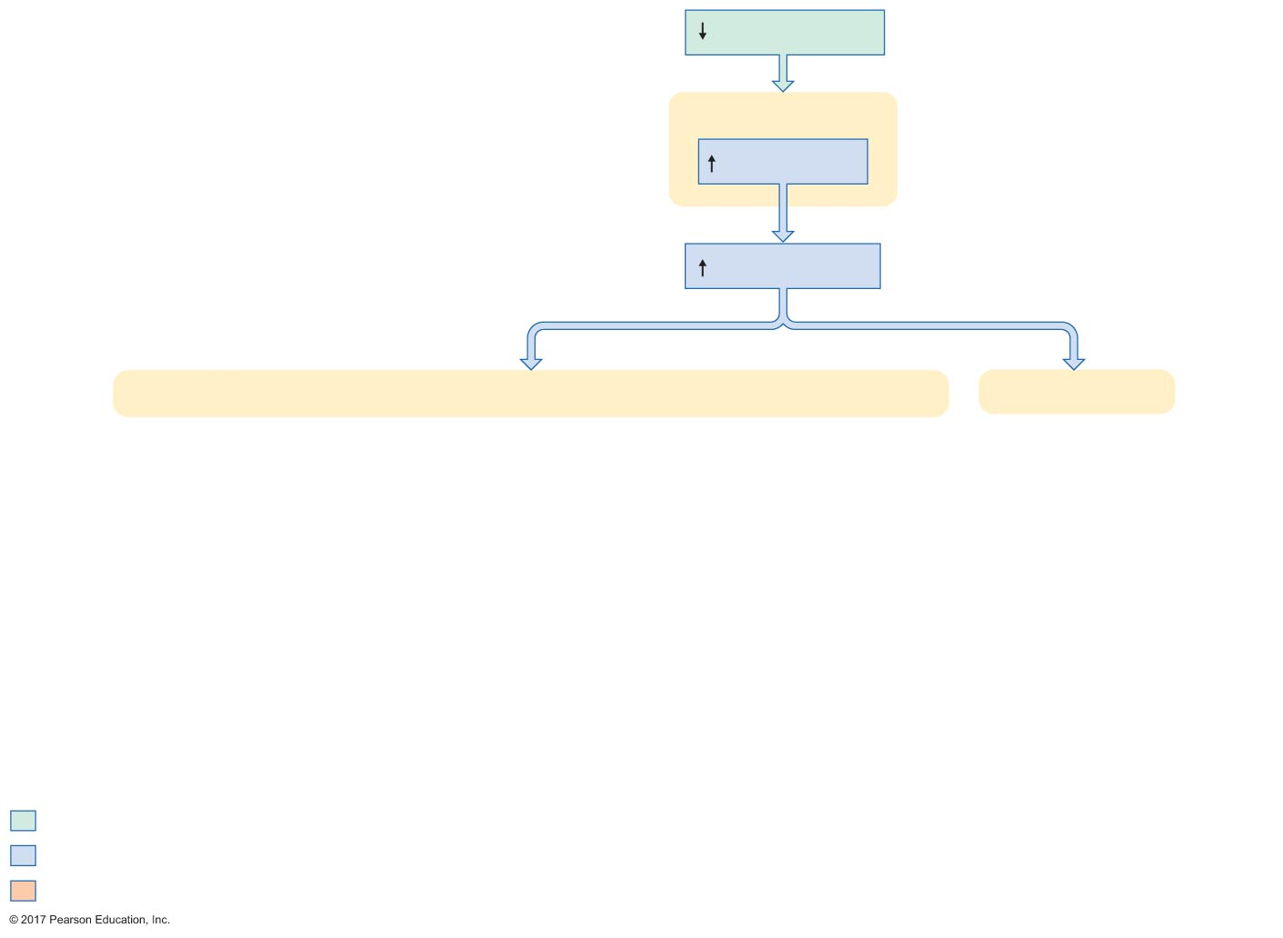
Figure 19.22 Role of parathyroid hormone in calcium balance.
Slide 3
[Ca²⁺] in plasma
Parathyroid glands
PTH secretion
[PTH] in plasma
Kidneys
Bone
Initial stimulus
Physiological response
Result

Slide 55
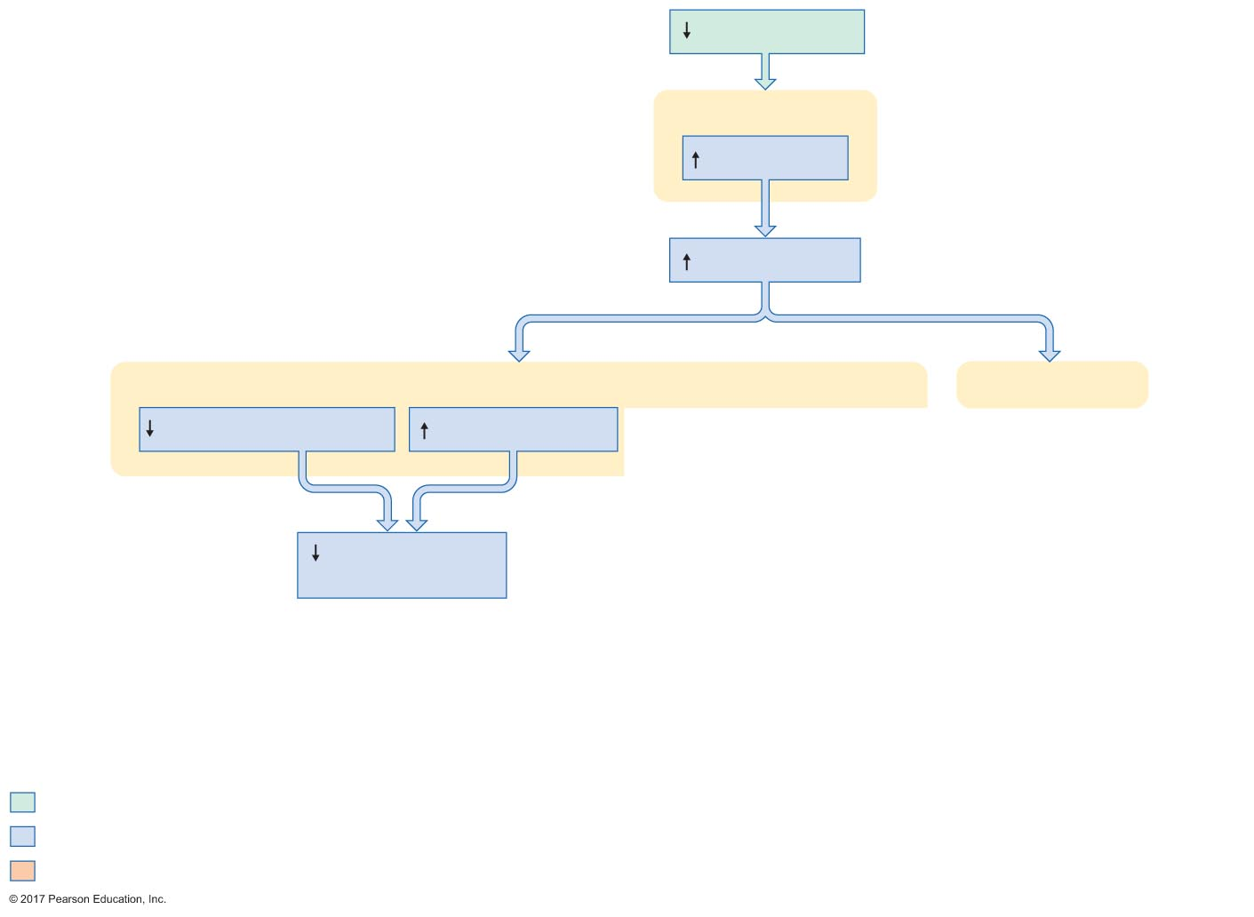
Figure 19.22 Role of parathyroid hormone in calcium balance.
Slide 4
[Ca²⁺] in plasma
Parathyroid glands
PTH secretion
[PTH] in plasma
Kidneys
Bone
Phosphate reabsorption
Ca²⁺ reabsorption
Calcium excretion
in urine
Initial stimulus
Physiological response
Result

Slide 56
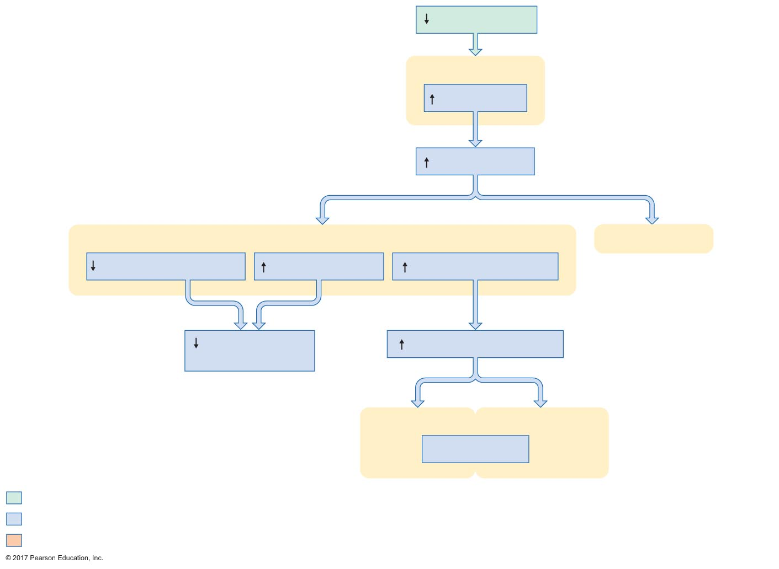
Figure 19.22 Role of parathyroid hormone in calcium balance.
Slide 5
[Ca²⁺] in plasma
Parathyroid glands
PTH secretion
[PTH] in plasma
Kidneys
Bone
Phosphate reabsorption
Ca²⁺ reabsorption
1,25-(OH₂)D₃ activation
Calcium excretion
in urine
[1,25-(OH₂)D₃] in plasma
Kidneys
Gastrointestinal tract
Ca²⁺ absorption
Initial stimulus
Physiological response
Result

Slide 57
Figure 19.22 Role of parathyroid hormone in calcium balance.
Slide 6
[Ca²⁺] in plasma
Parathyroid glands
PTH secretion
Negative
feedback
[PTH] in plasma
Kidneys
Bone
Phosphate reabsorption
Ca²⁺ reabsorption
1,25-(OH₂)D₃ activation
Ca²⁺ resorption
Calcium excretion
in urine
[1,25-(OH₂)D₃] in plasma
Negative
feedback
Kidneys
Gastrointestinal tract
Ca²⁺ absorption
Initial stimulus
Physiological response
Result
[Ca²⁺] in plasma

Slide 58
Hormonal Control of Plasma Calcium Concentrations
1,25-dihydroxycholecalciferol: steroid hormone derived from vitamin D₃

Slide 59
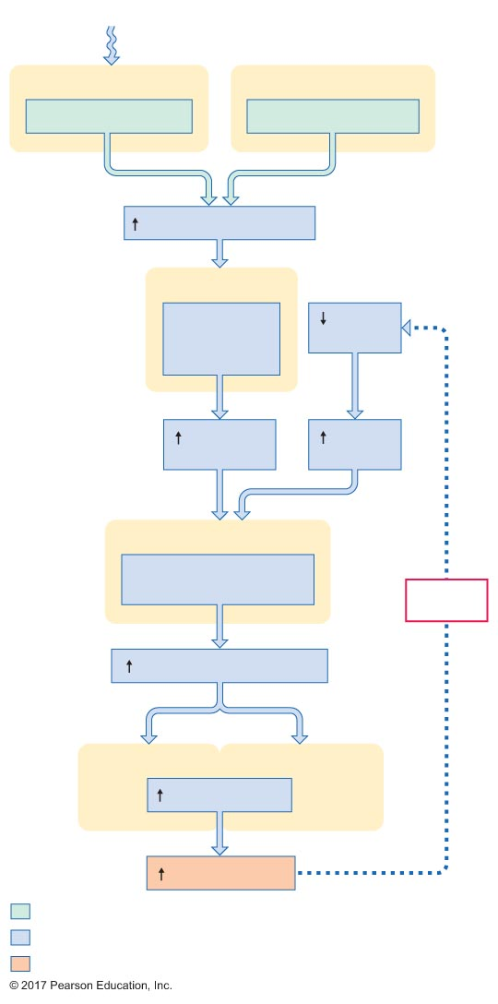
Figure 19.23 Activation of 1,25-(OH₂)D₃.
Slide 1
Sunlight
Skin
Gastrointestinal tract
7-dehydrocholesterol
Vitamin D₃ absorption
[Vitamin D₃] in plasma
Liver
Conversion of
vitamin D₃
to 25-OH D₃
[Ca²⁺] in
plasma
[25-OH D₃]
in plasma
[PTH] in
plasma
Kidneys
Conversion of 25-OH D₃
to 1,25-(OH₂)D₃
Negative
feedback
[1,25-(OH₂)D₃] in plasma
Kidneys
Gastrointestinal tract
Ca²⁺ absorption
[Ca²⁺] in plasma
Initial stimulus
Physiological response
Result

Slide 60
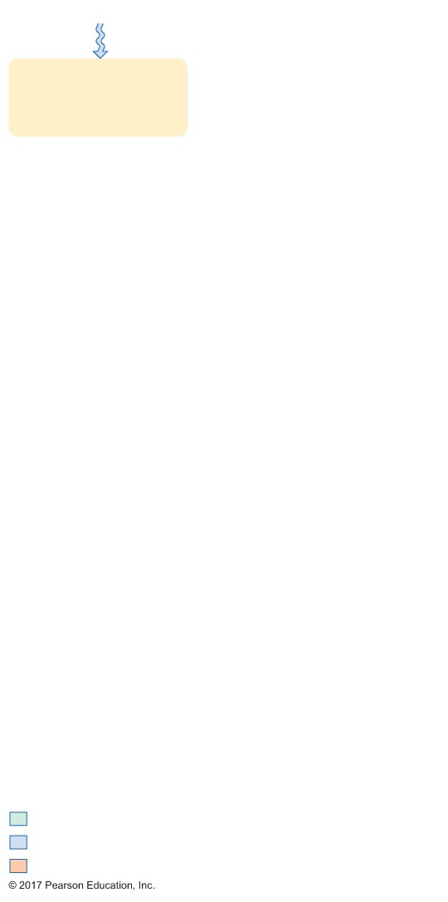
Figure 19.23 Activation of 1,25-(OH₂)D₃.
Slide 2
Sunlight
Skin
Initial stimulus
Physiological response
Result

Slide 61
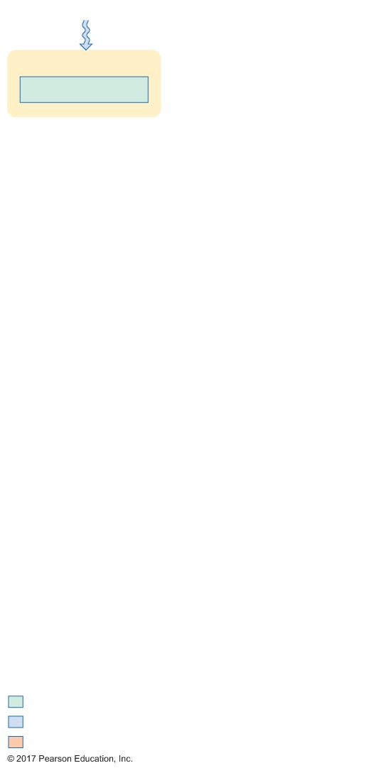
Figure 19.23 Activation of 1,25-(OH₂)D₃.
Slide 3
Sunlight
Skin
7-dehydrocholesterol
Initial stimulus
Physiological response
Result

Slide 62
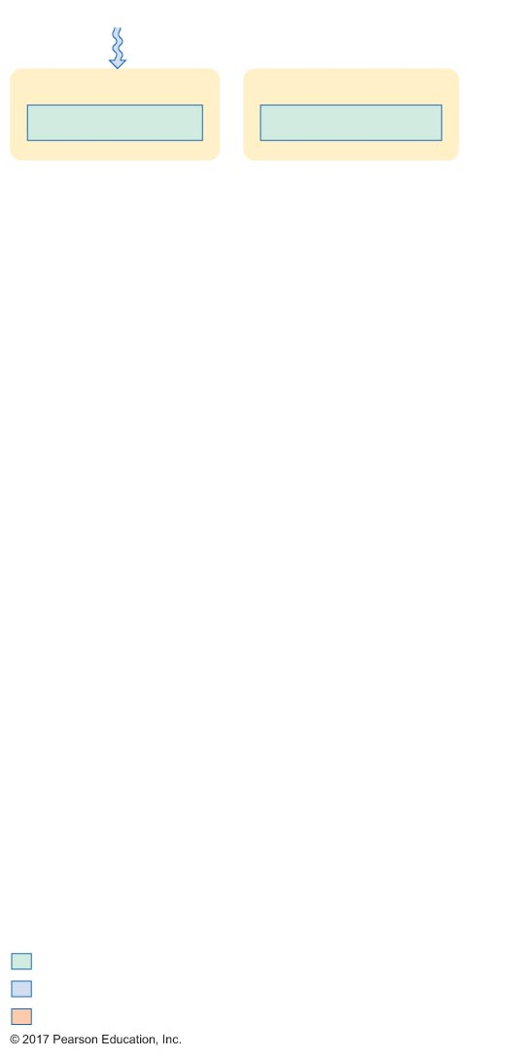
Figure 19.23 Activation of 1,25-(OH₂)D₃.
Slide 4
Sunlight
Skin
Gastrointestinal tract
7-dehydrocholesterol
Vitamin D₃ absorption
Initial stimulus
Physiological response
Result

Slide 63
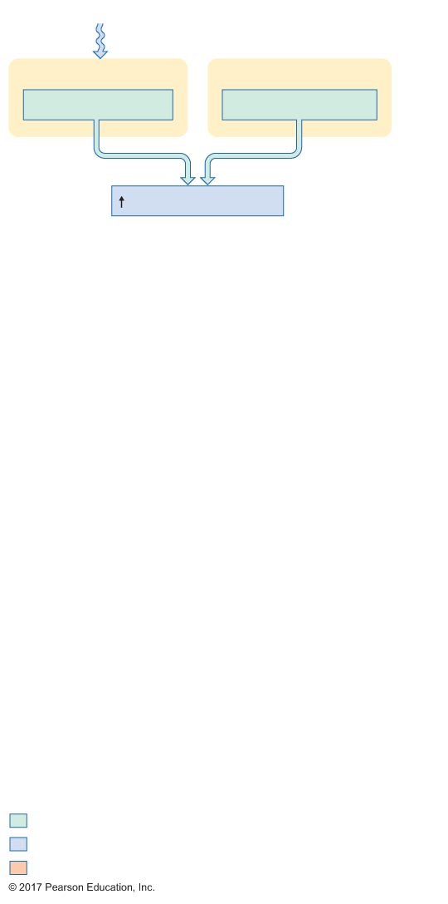
Figure 19.23 Activation of 1,25-(OH₂)D₃.
Slide 5
Sunlight
Skin
Gastrointestinal tract
7-dehydrocholesterol
Vitamin D₃ absorption
[Vitamin D₃] in plasma
Initial stimulus
Physiological response
Result

Slide 64
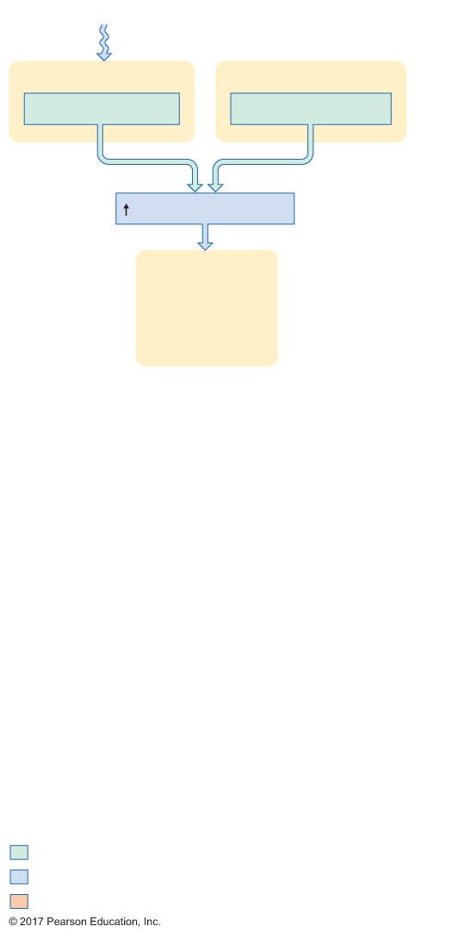
Figure 19.23 Activation of 1,25-(OH₂)D₃.
Slide 6
Sunlight
Skin
Gastrointestinal tract
7-dehydrocholesterol
Vitamin D₃ absorption
[Vitamin D₃] in plasma
Liver
Initial stimulus
Physiological response
Result

Slide 65
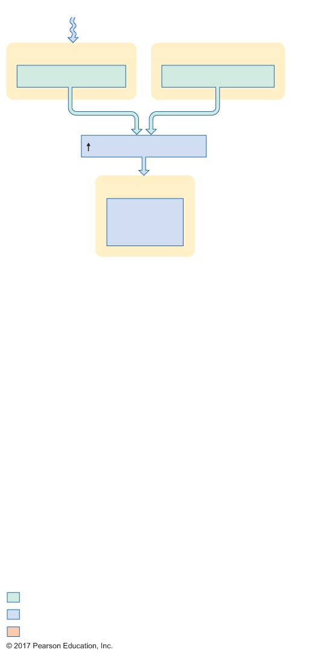
Figure 19.23 Activation of 1,25-(OH₂)D₃.
Slide 7
Sunlight
Skin
Gastrointestinal tract
7-dehydrocholesterol
Vitamin D₃ absorption
[Vitamin D₃] in plasma
Liver
Conversion of
vitamin D₃
to 25-OH D₃
Initial stimulus
Physiological response
Result

Slide 66
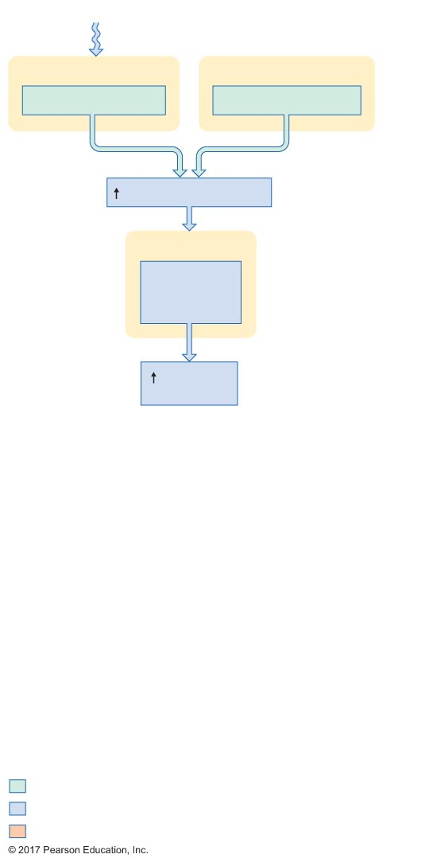
Figure 19.23 Activation of 1,25-(OH₂)D₃.
Slide 8
Sunlight
Skin
Gastrointestinal tract
7-dehydrocholesterol
Vitamin D₃ absorption
[Vitamin D₃] in plasma
Liver
Conversion of
vitamin D₃
to 25-OH D₃
[25-OH D₃]
in plasma
Initial stimulus
Physiological response
Result

Slide 67
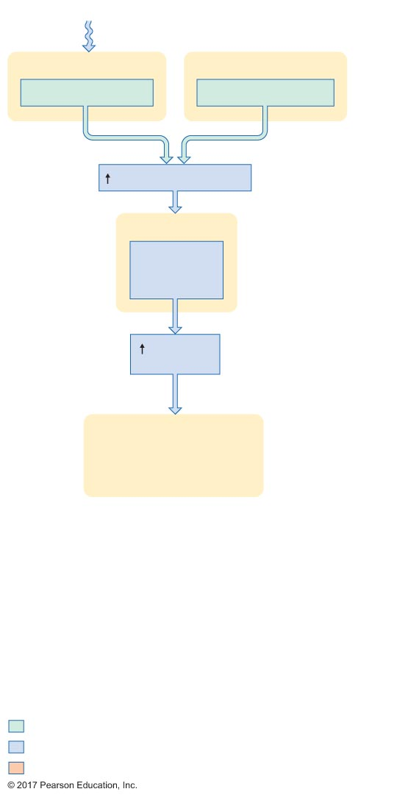
Figure 19.23 Activation of 1,25-(OH₂)D₃.
Slide 9
Sunlight
Skin
Gastrointestinal tract
7-dehydrocholesterol
Vitamin D₃ absorption
[Vitamin D₃] in plasma
Liver
Conversion of
vitamin D₃
to 25-OH D₃
[25-OH D₃]
in plasma
Kidneys
Initial stimulus
Physiological response
Result

Slide 68
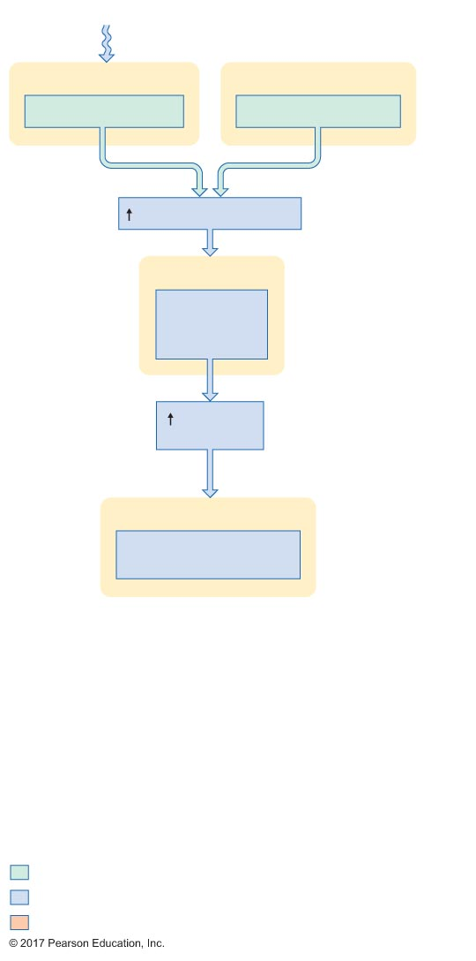
Figure 19.23 Activation of 1,25-(OH₂)D₃.
Slide 10
Sunlight
Skin
Gastrointestinal tract
7-dehydrocholesterol
Vitamin D₃ absorption
[Vitamin D₃] in plasma
Liver
Conversion of
vitamin D₃
to 25-OH D₃
[25-OH D₃]
in plasma
Kidneys
Conversion of 25-OH D₃
to 1,25-(OH₂)D₃
Initial stimulus
Physiological response
Result

Slide 69
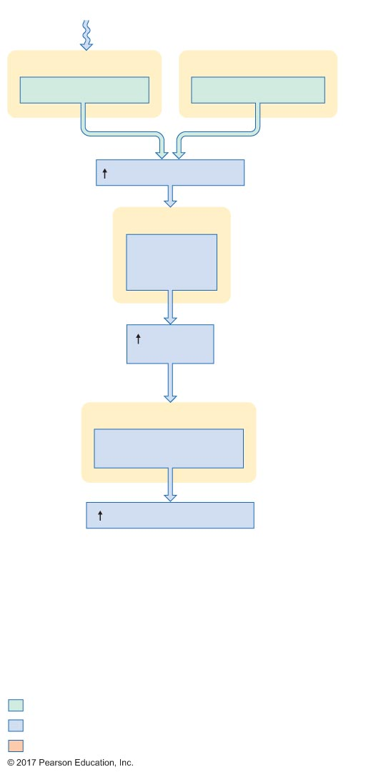
Figure 19.23 Activation of 1,25-(OH₂)D₃.
Slide 11
Sunlight
Skin
Gastrointestinal tract
7-dehydrocholesterol
Vitamin D₃ absorption
[Vitamin D₃] in plasma
Liver
Conversion of
vitamin D₃
to 25-OH D₃
[25-OH D₃]
in plasma
Kidneys
Conversion of 25-OH D₃
to 1,25-(OH₂)D₃
[1,25-(OH₂)D₃] in plasma
Initial stimulus
Physiological response
Result

Slide 70

Figure 19.23 Activation of 1,25-(OH₂)D₃.
Slide 12
Sunlight
Skin
Gastrointestinal tract
7-dehydrocholesterol
Vitamin D₃ absorption
[Vitamin D₃] in plasma
Liver
Conversion of
vitamin D₃
to 25-OH D₃
[25-OH D₃]
in plasma
Kidneys
Conversion of 25-OH D₃
to 1,25-(OH₂)D₃
[1,25-(OH₂)D₃] in plasma
Kidneys
Gastrointestinal tract
Ca²⁺ absorption
Initial stimulus
Physiological response
Result

Slide 71

Figure 19.23 Activation of 1,25-(OH₂)D₃.
Slide 13
Sunlight
Skin
Gastrointestinal tract
7-dehydrocholesterol
Vitamin D₃ absorption
[Vitamin D₃] in plasma
Liver
Conversion of
vitamin D₃
to 25-OH D₃
[25-OH D₃]
in plasma
Kidneys
Conversion of 25-OH D₃
to 1,25-(OH₂)D₃
[1,25-(OH₂)D₃] in plasma
Kidneys
Gastrointestinal tract
Ca²⁺ absorption
[Ca²⁺] in plasma
Initial stimulus
Physiological response
Result

Slide 72

Figure 19.23 Activation of 1,25-(OH₂)D₃.
Slide 14
Sunlight
Skin
Gastrointestinal tract
7-dehydrocholesterol
Vitamin D₃ absorption
[Vitamin D₃] in plasma
Liver
Conversion of
vitamin D₃
to 25-OH D₃
[Ca²⁺] in
plasma
[25-OH D₃]
in plasma
Kidneys
Conversion of 25-OH D₃
to 1,25-(OH₂)D₃
Negative
feedback
[1,25-(OH₂)D₃] in plasma
Kidneys
Gastrointestinal tract
Ca²⁺ absorption
[Ca²⁺] in plasma
Initial stimulus
Physiological response
Result

Slide 73

Figure 19.23 Activation of 1,25-(OH₂)D₃.
Slide 15
Sunlight
Skin
Gastrointestinal tract
7-dehydrocholesterol
Vitamin D₃ absorption
[Vitamin D₃] in plasma
Liver
Conversion of
vitamin D₃
to 25-OH D₃
[Ca²⁺] in
plasma
[25-OH D₃]
in plasma
[PTH] in
plasma
Kidneys
Conversion of 25-OH D₃
to 1,25-(OH₂)D₃
Negative
feedback
[1,25-(OH₂)D₃] in plasma
Kidneys
Gastrointestinal tract
Ca²⁺ absorption
[Ca²⁺] in plasma
Initial stimulus
Physiological response
Result

Slide 74
Figure 19.23 Activation of 1,25-(OH₂)D₃.
Slide 16
Sunlight
Skin
Gastrointestinal tract
7-dehydrocholesterol
Vitamin D₃ absorption
[Vitamin D₃] in plasma
Liver
Conversion of
vitamin D₃
to 25-OH D₃
[Ca²⁺] in
plasma
[25-OH D₃]
in plasma
[PTH] in
plasma
Kidneys
Conversion of 25-OH D₃
to 1,25-(OH₂)D₃
Negative
feedback
[1,25-(OH₂)D₃] in plasma
Kidneys
Gastrointestinal tract
Ca²⁺ absorption
[Ca²⁺] in plasma
Initial stimulus
Physiological response
Result

Slide 75
Hormonal Control of Plasma Calcium Concentrations
Calcitonin
Secreted from C cells of thyroid gland
Release triggered by high plasma [Ca²⁺]
Actions at target cells
Increases bone formation
Decreases calcium reabsorption by kidneys

